Slide 1


Harnessing AI for Scientific Integrity
Dr. Sarah Rajtmajer
Associate Professor, College of IST
Senior Research Fellow, Rock Ethics Institute
https://www.rajtmajerlab.net

Slide 2

Chaos in the scientific ecosystem
A First Look at the Reproducibility Crisis

Slide 3
Pile of bricks with no clear structure?
A First Look at the Reproducibility Crisis
Rapid growth of scientific literature
Sometimes findings are incompatiable
Sometimes findings are compatible-ish or (better) when taken together offer a more complete picture
Lack of direct attempts to replicate findings
Lack of direct attempts to falsify hypotheses
Low-credibility journals, etc...
How to make sense of it of all ?

Slide 4
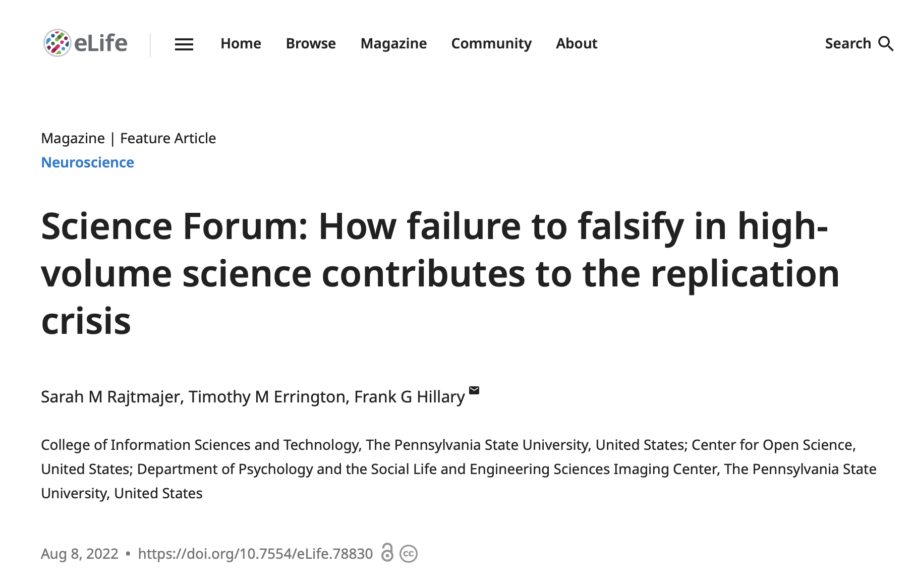
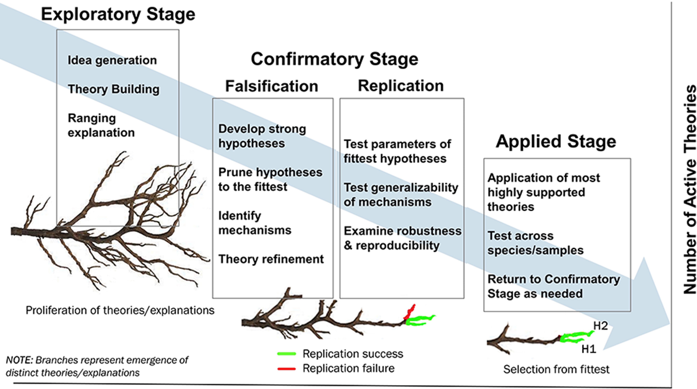

Slide 5
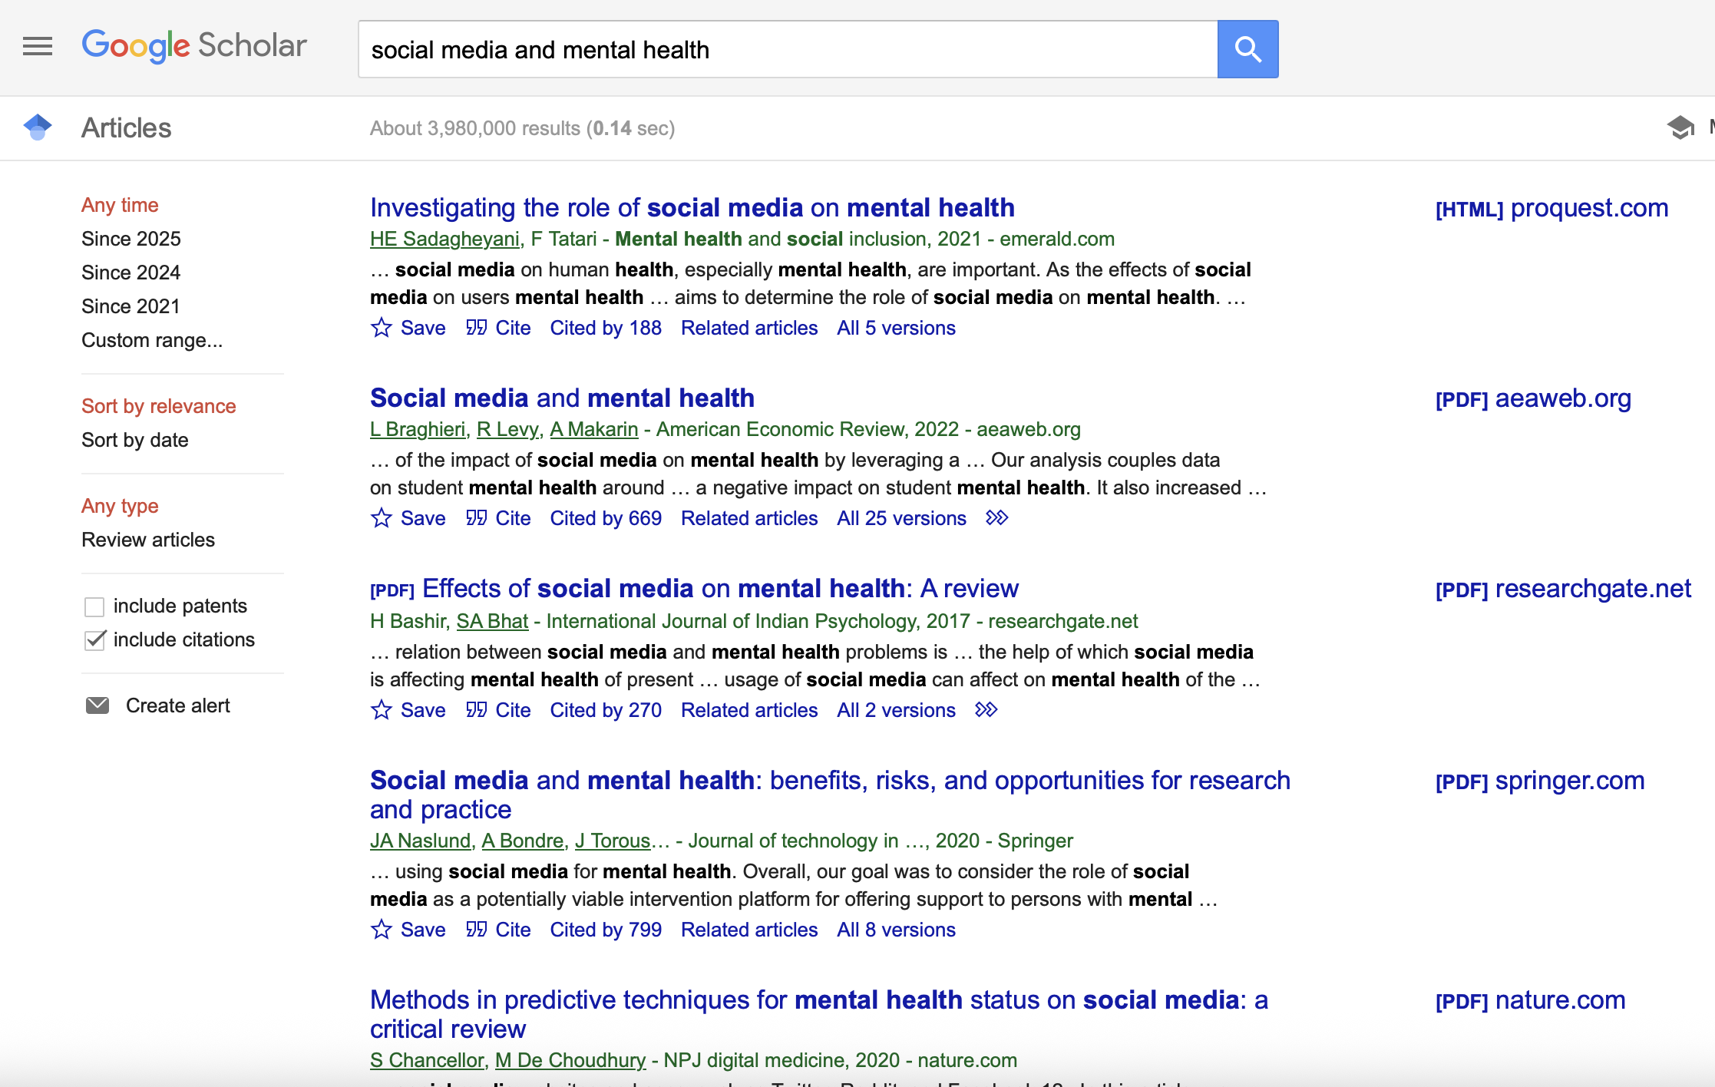
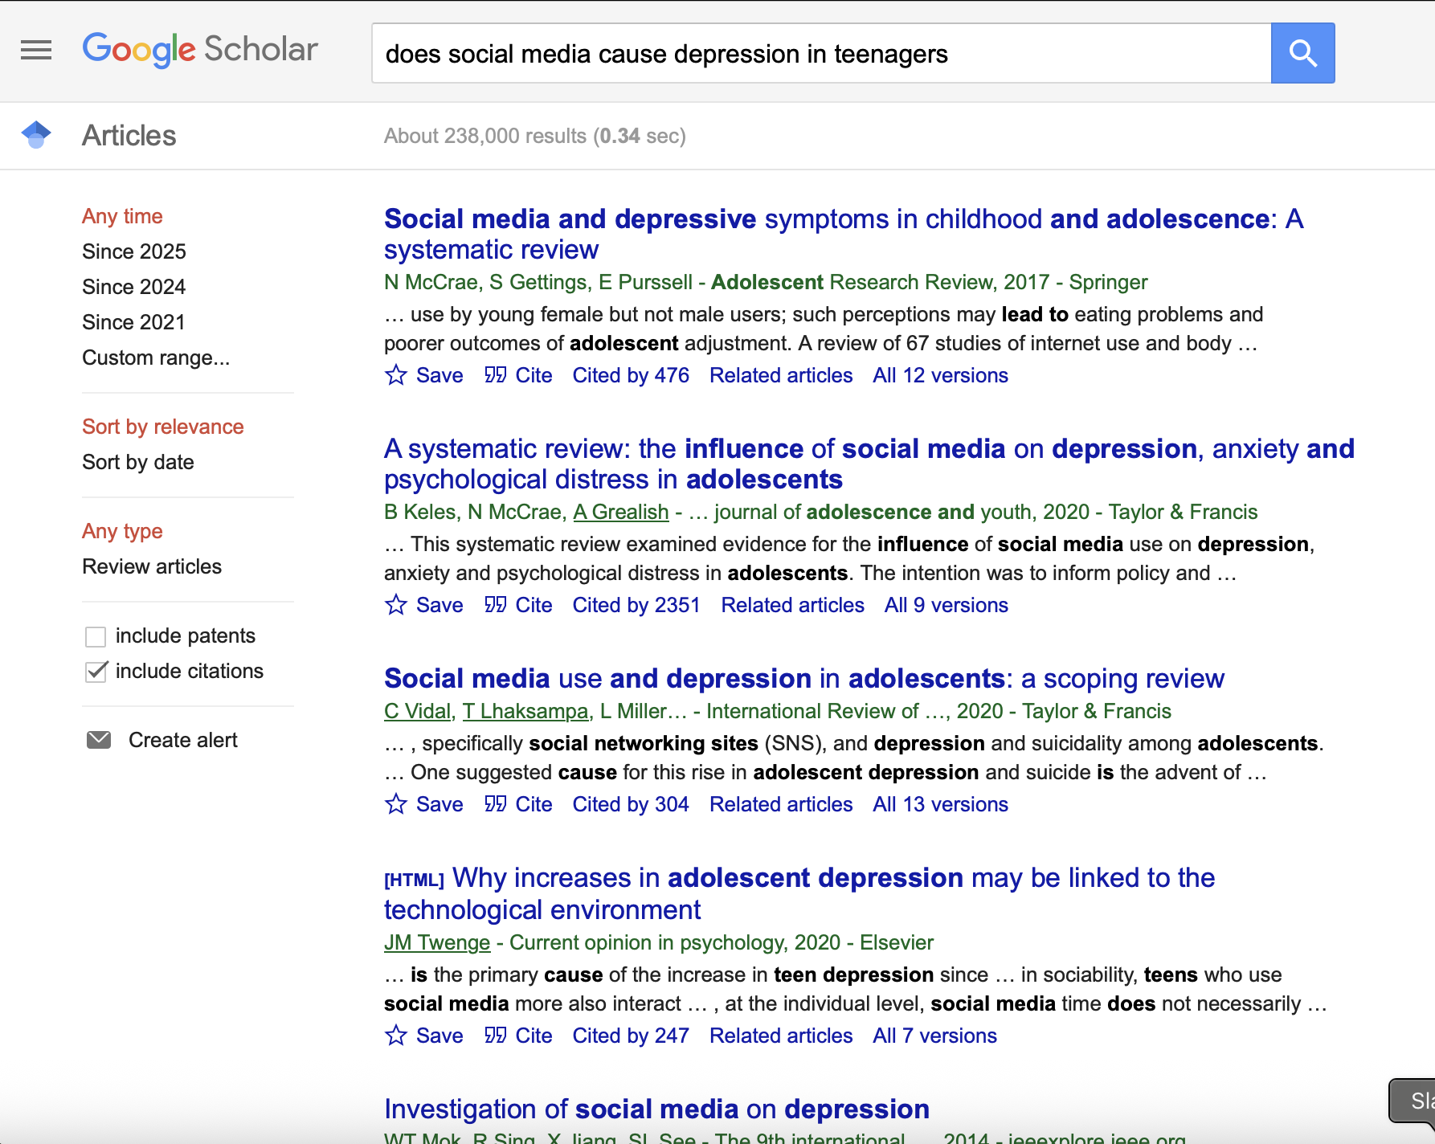
Making sense of the literature: today
A First Look at the Reproducibility Crisis

Slide 6
Making sense of the literature: the vision
A First Look at the Reproducibility Crisis
A machine-readable (+ computable, as appropriate) scholarly record
I’m interested in social media and mental health…
-Is social media bad for mental health (consensus!?)
-Do studies of teenagers say different things than studies of adults and older people?
-Do studies look at gender as a variable?
-Does the specific social media/platform matter?
etc. etc. etc….

Slide 7
What would we need to enable this vision?
A First Look at the Reproducibility Crisis
Extract key information from papers in an automated fashion (from narrative text, usually PDFs) and store it efficiently (can be queried)
Synthesize key information in ways that are useful and can be built upon to answer questions that matter.
Figure out how “credible” stated findings are at the individual level (reproducible, replicable, robust, generalizable)… (automatically reproduce/replicate?)

Slide 8
What would we need to enable this vision?
A First Look at the Reproducibility Crisis
Extract key information from papers in an automated fashion (from narrative text, usually PDFs) and store it efficiently (can be queried)
Synthesize key information in ways that are useful and can be built upon to answer questions that matter.
Figure out how “credible” stated findings are at the individual level (reproducible, replicable, robust, generalizable)… (automatically reproduce/replicate?)

Slide 9
“Information extraction” is really hard.
A First Look at the Reproducibility Crisis
Natural language processing (NLP)
Information Extraction (IE)
-Named Entity Recognition (NER)
-Relationship Extraction
Natural language understanding (NLU)
-Semantic parsing
-Semantic role labeling

Slide 10
Why is it so hard?
Because the way we disseminate/share our scientific efforts and findings was never intended for machine readability.
It is a relic of a very different time.

Slide 11
“Information extraction” is really hard.
A First Look at the Reproducibility Crisis
Natural language processing (NLP)
Information Extraction (IE)
-Named Entity Recognition (NER)
-Relationship Extraction
Natural language understanding (NLU) & Natural language inference (NLI)
-Semantic parsing
-Semantic role labeling

Slide 12
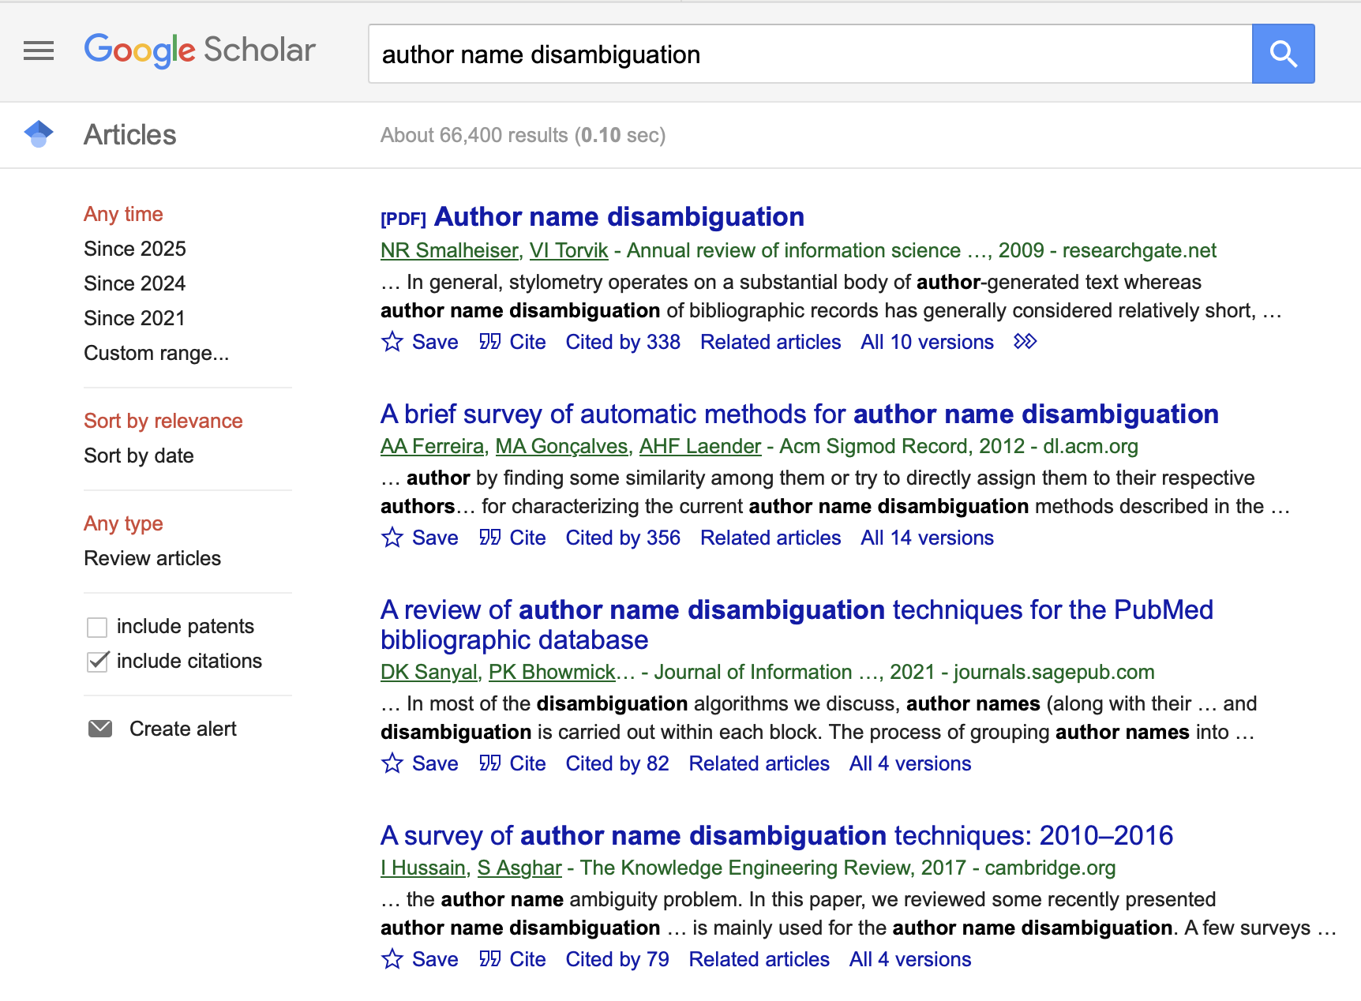
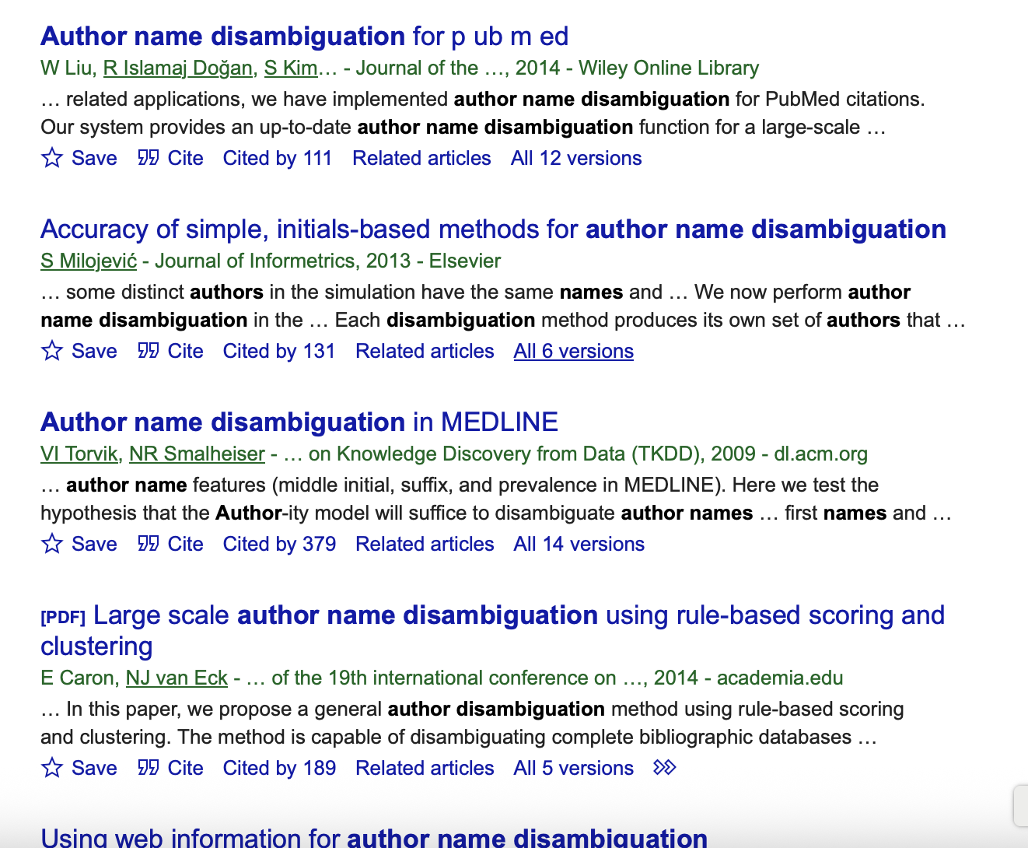

Slide 13

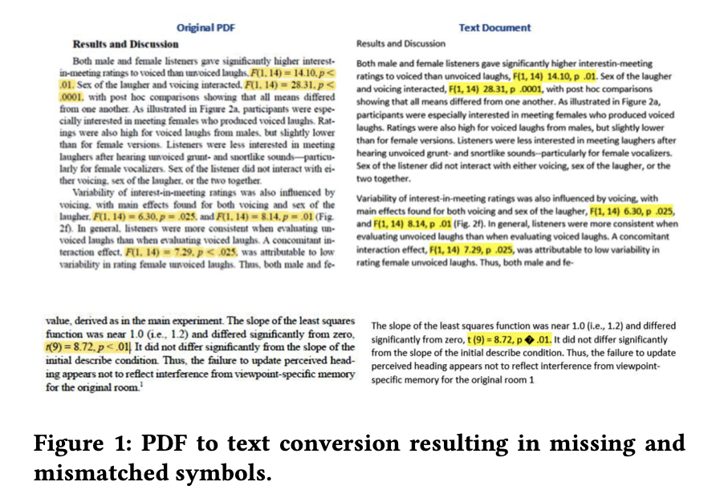
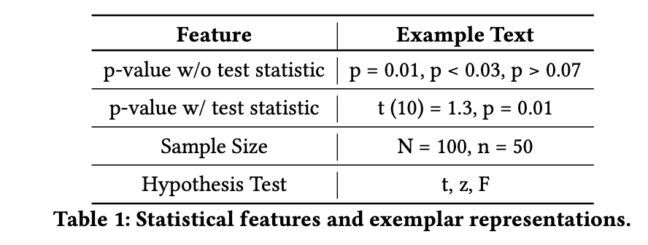
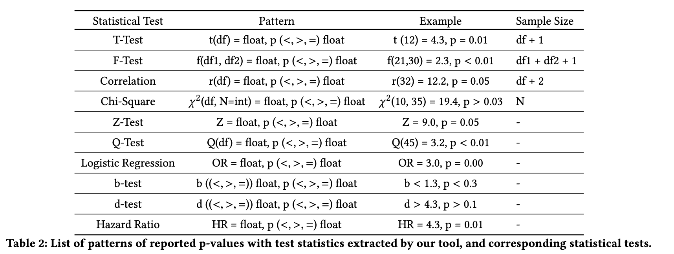

Slide 14

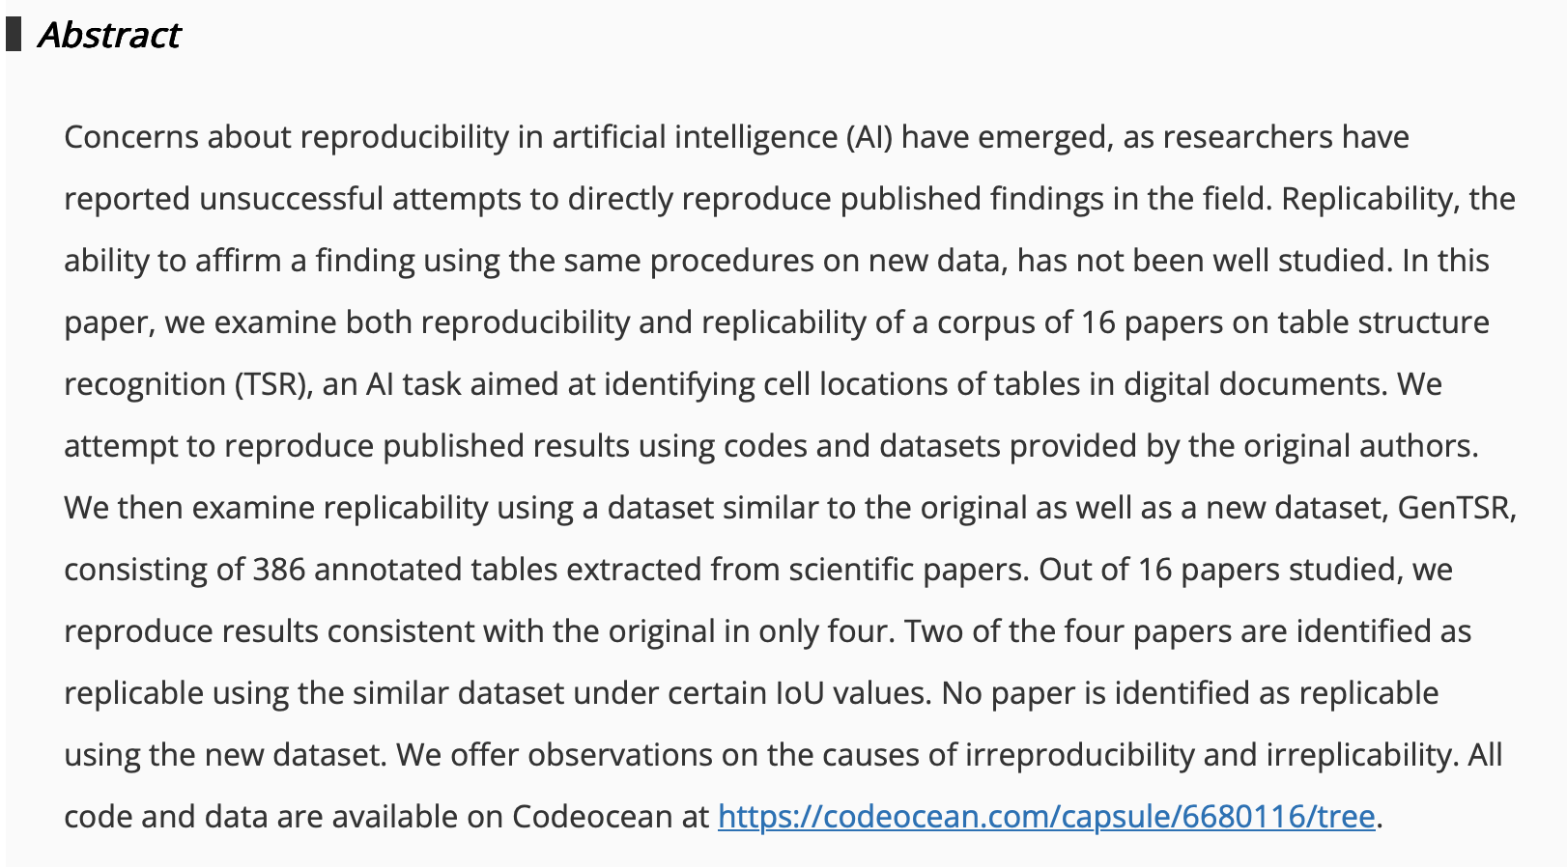

Slide 15
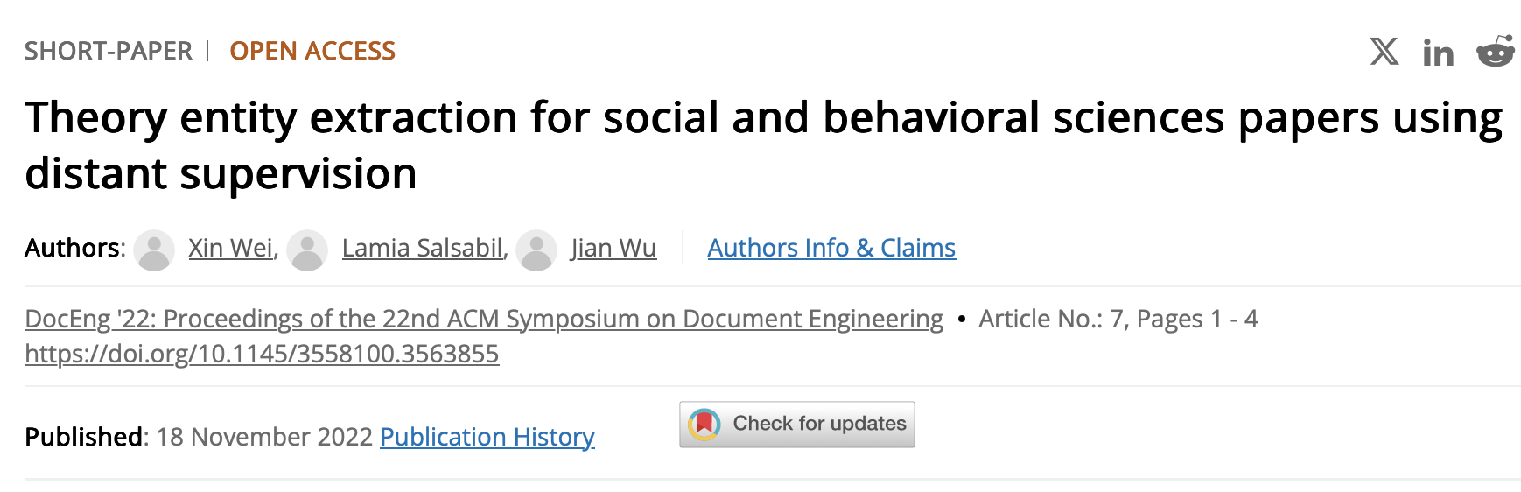
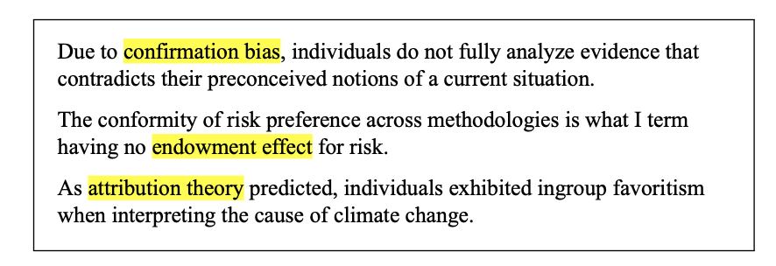
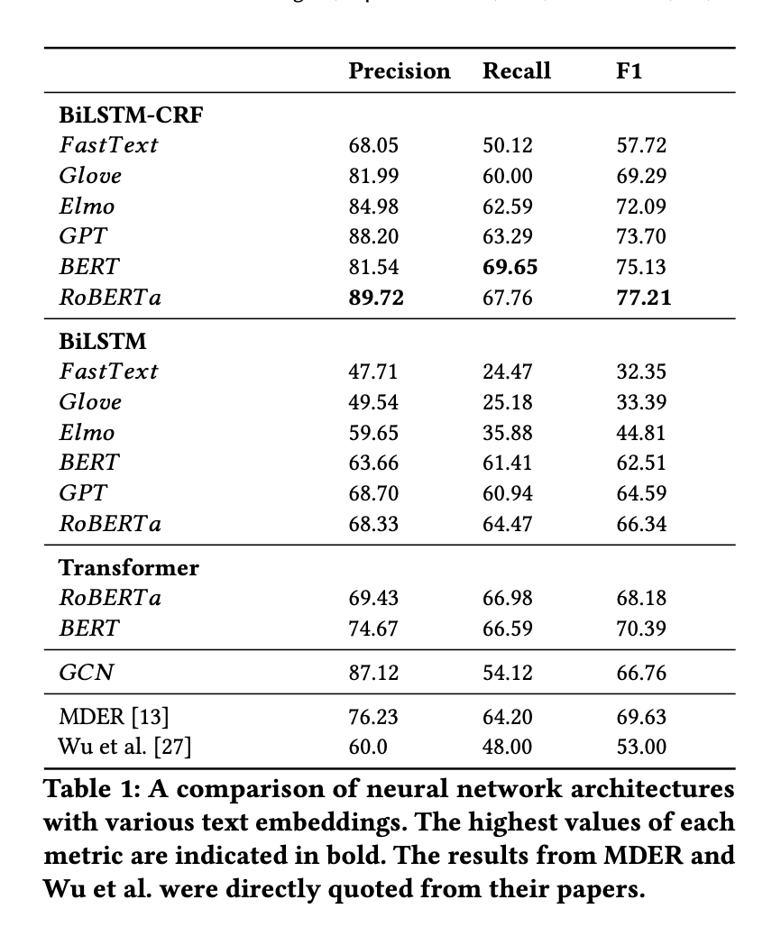
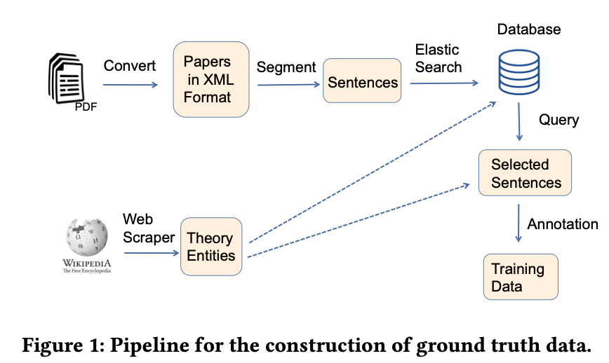

Slide 16
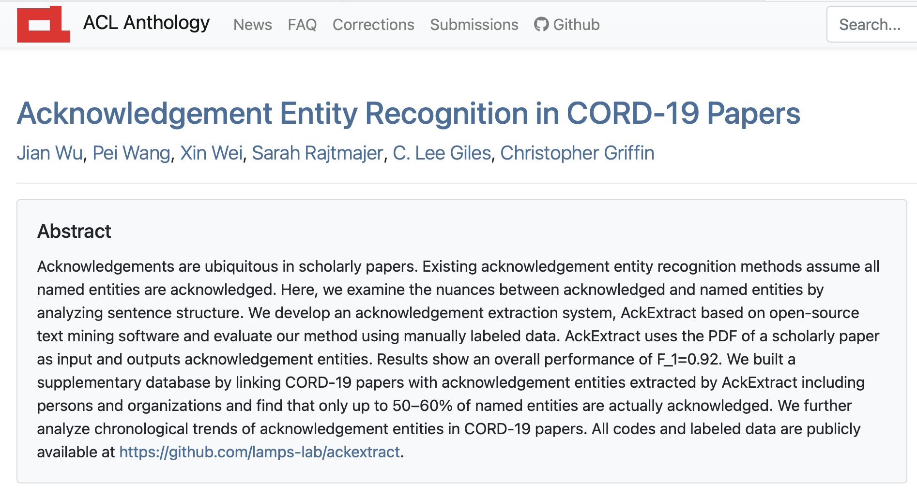
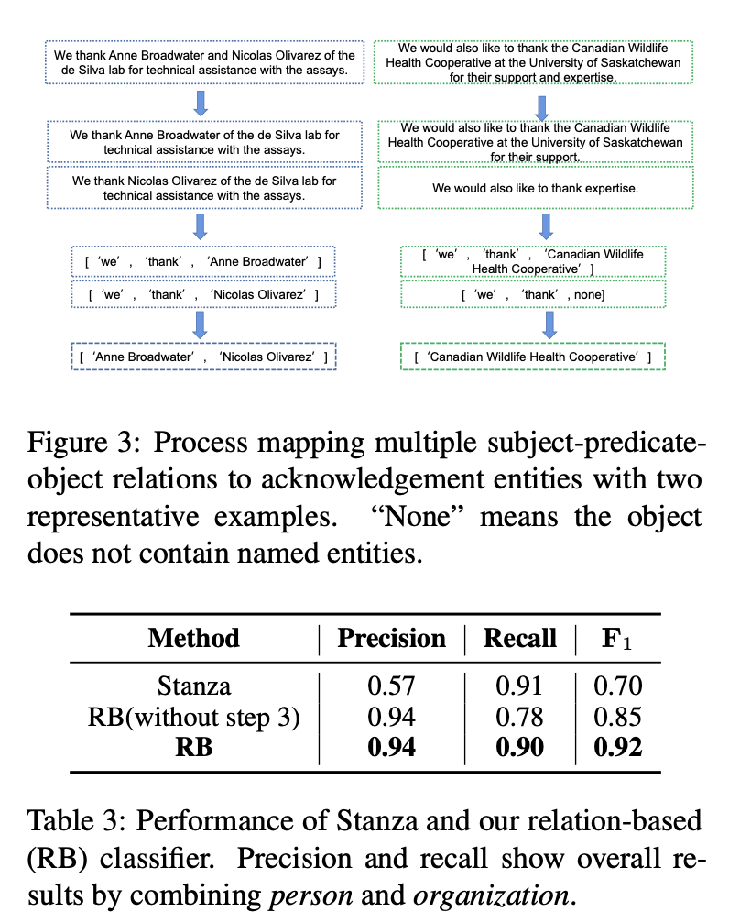
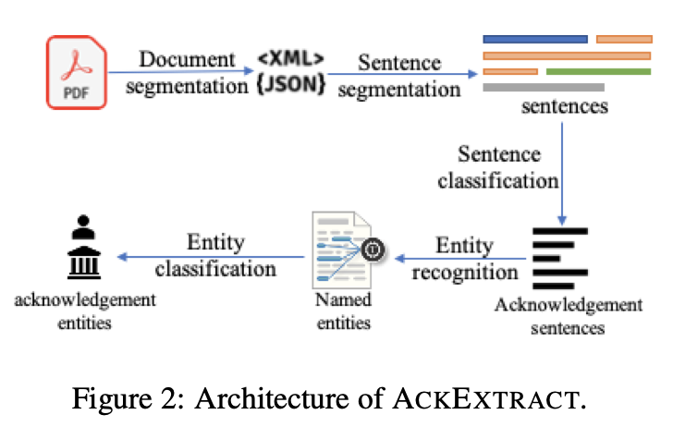
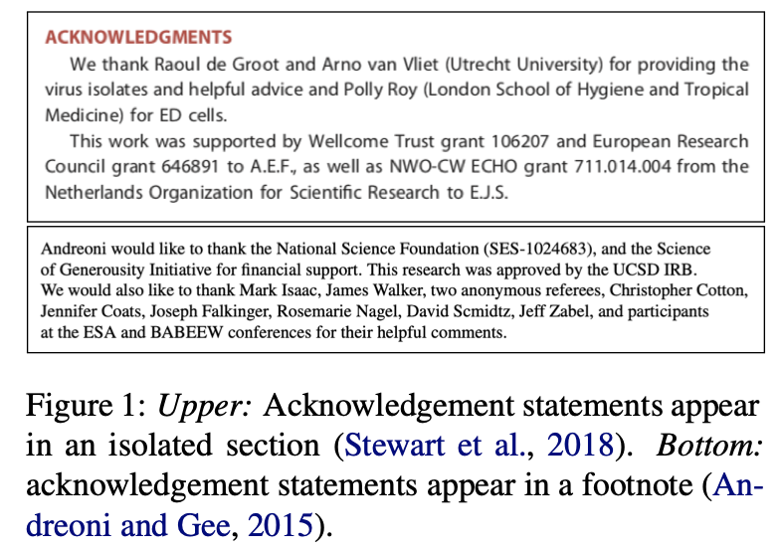

Slide 17
What would we need to enable this vision?
A First Look at the Reproducibility Crisis
Extract key information from papers in an automated fashion (from narrative text, usually PDFs) and store it efficiently (can be queried)
Synthesize key information in ways that are useful and can be built upon to answer questions that matter.
Figure out how “credible” stated findings are at the individual level (reproducible, replicable, robust, generalizable)… (automatically reproduce/replicate?)

Slide 18
Sensemaking
A First Look at the Reproducibility Crisis
Natural language processing (NLP)
Information Extraction (IE)
-Named Entity Recognition (NER)
-Relationship Extraction
Natural language understanding (NLU) &
Natural language inference (NLI)
-Semantic parsing
-Semantic role labeling

Slide 19
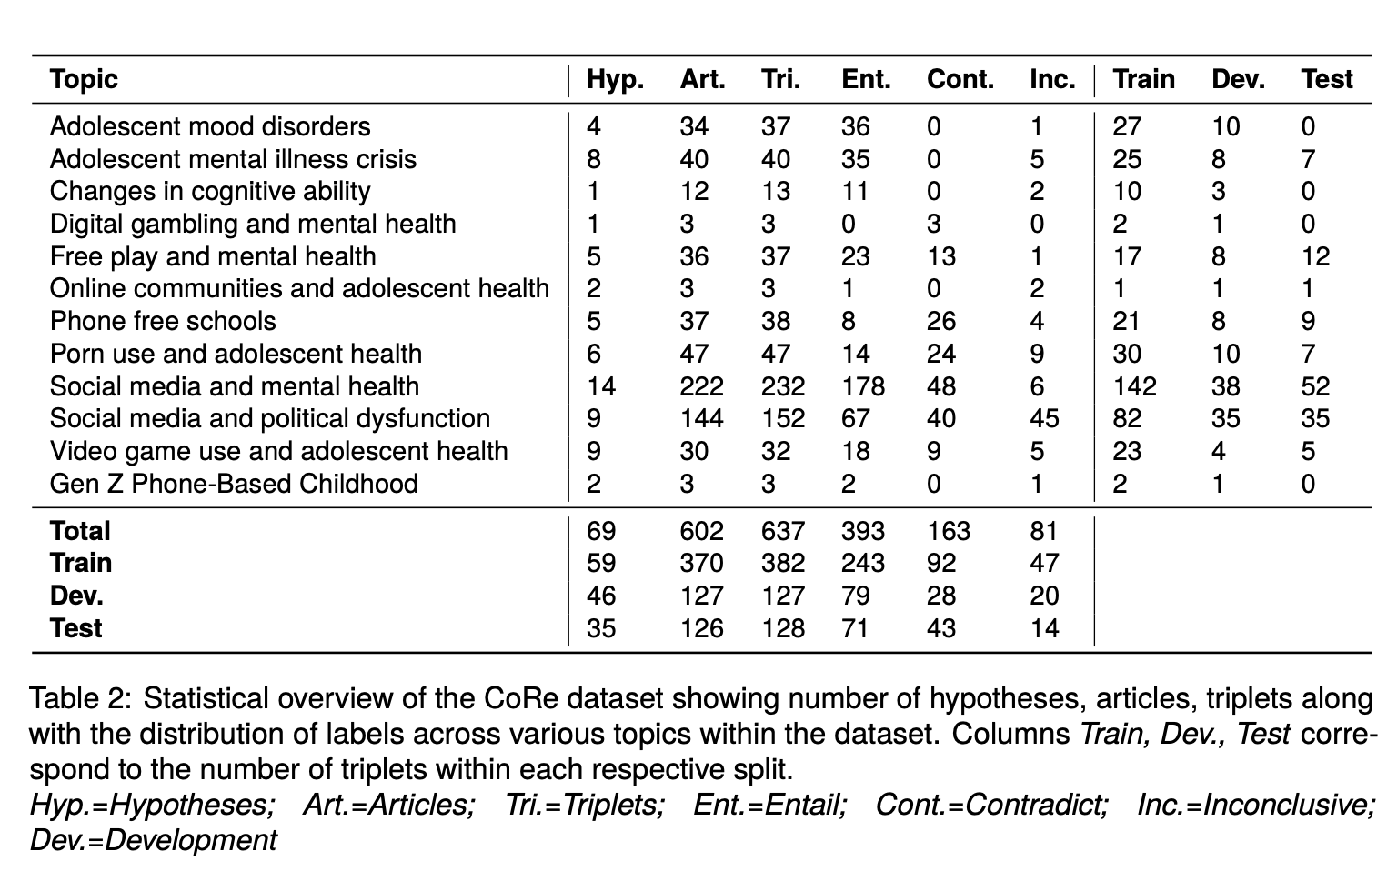
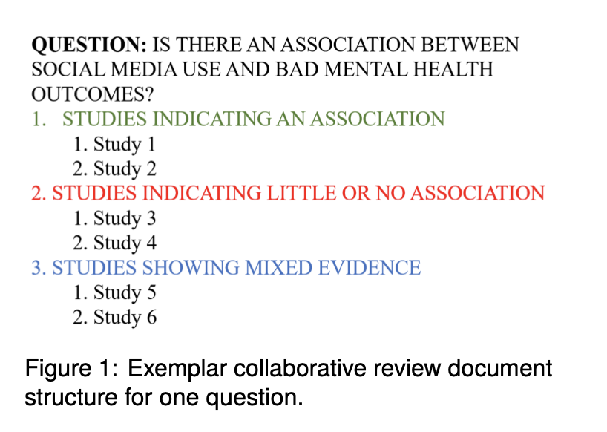
Our inspiration
https://jonathanhaidt.com/reviews/

Slide 20
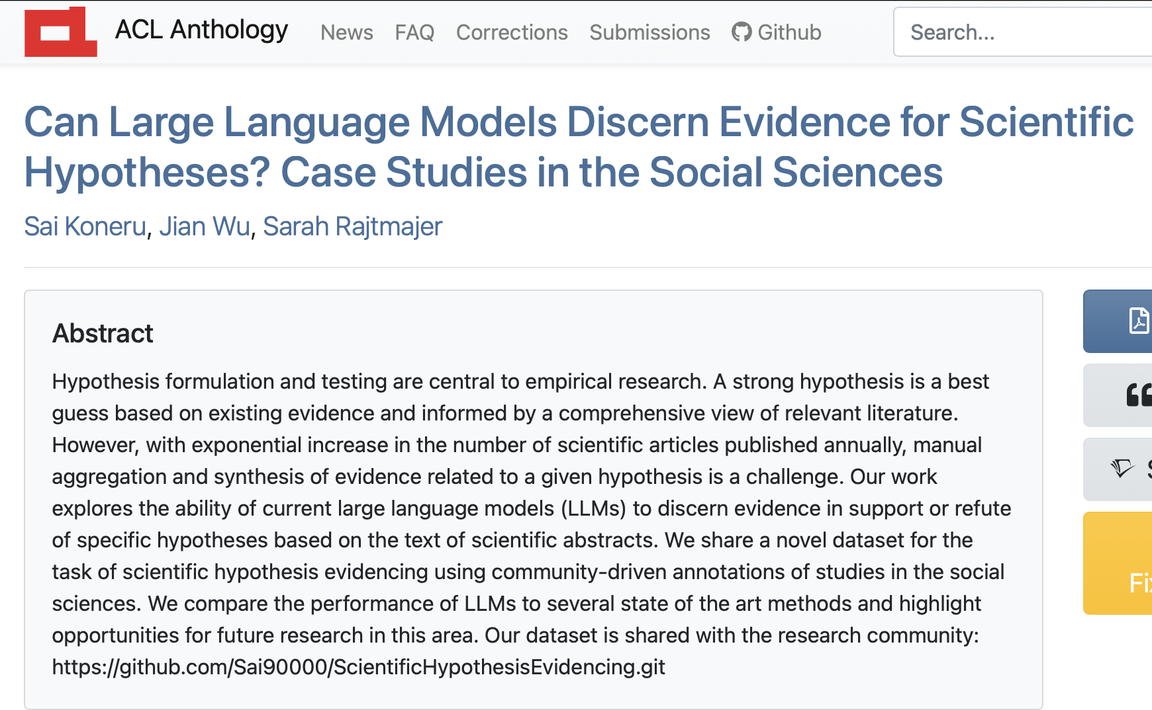
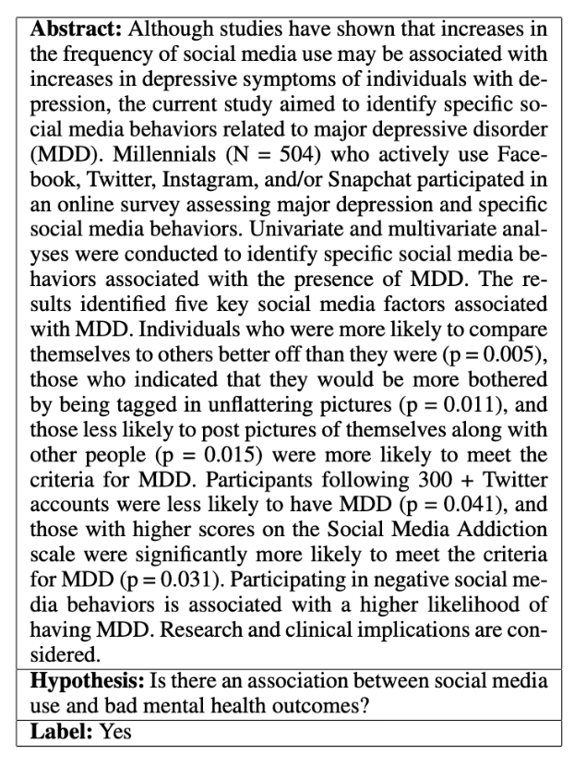
Next steps for IARPA REASON
Can we automate these reviews?… LLMs

Slide 21
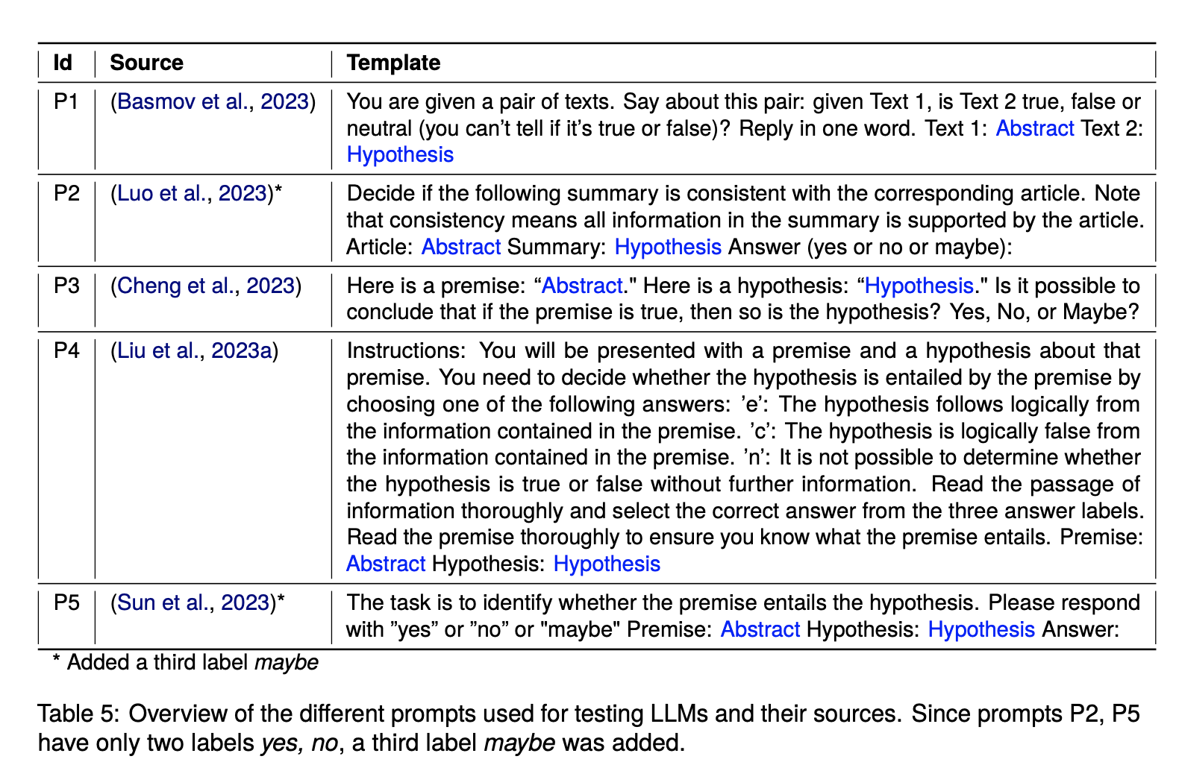

Slide 22
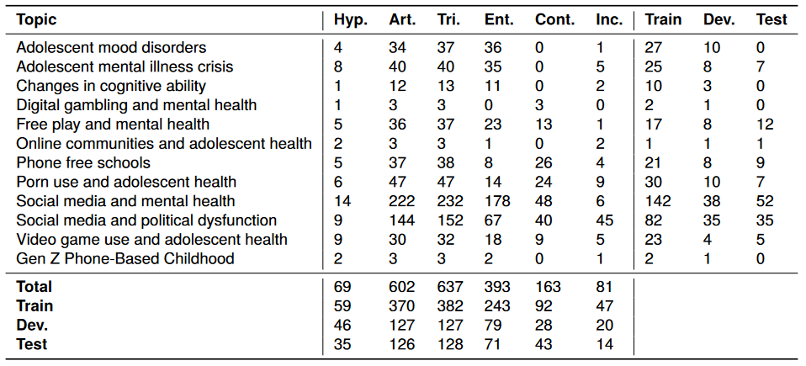
69 distinct hypotheses
61.6% entailment
602 scientific articles
25.7 % contradiction
638 triplets
12.7 % Inconclusive

Slide 23
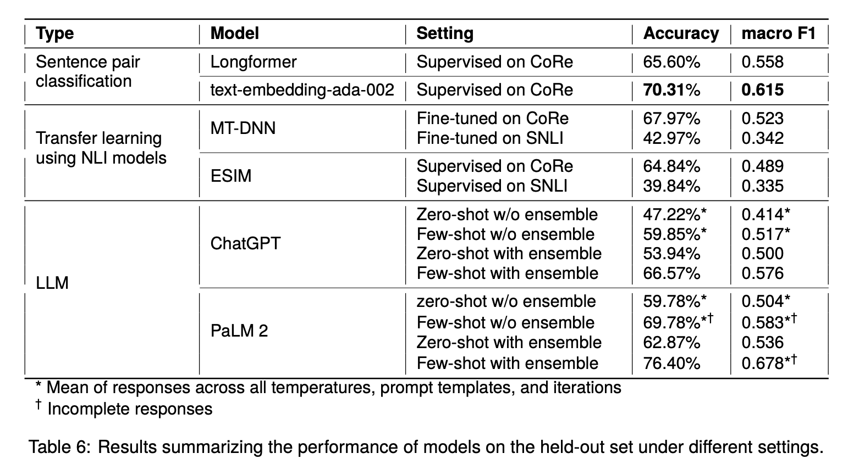

Slide 24
What would we need to enable this vision?
A First Look at the Reproducibility Crisis
Extract key information from papers in an automated fashion (from narrative text, usually PDFs) and store it efficiently (can be queried)
Synthesize key information in ways that are useful and can be built upon to answer questions that matter.
Figure out how “credible” stated findings are at the individual level (reproducible, replicable, robust, generalizable)… (automatically reproduce/replicate?)

Slide 25
Traditionally, run reproductions and replications (would be the gold standard)
…but also:
Journal reputation
Author/institution reputation
Does it “sound right”, use your own judgement (maybe things like theoretical grounding, sample size, statistical rigor etc.)…
Do other studies (that you’ve read) support the same?
Does it resonate with you pre-defined perspectives (biases)?

Slide 26

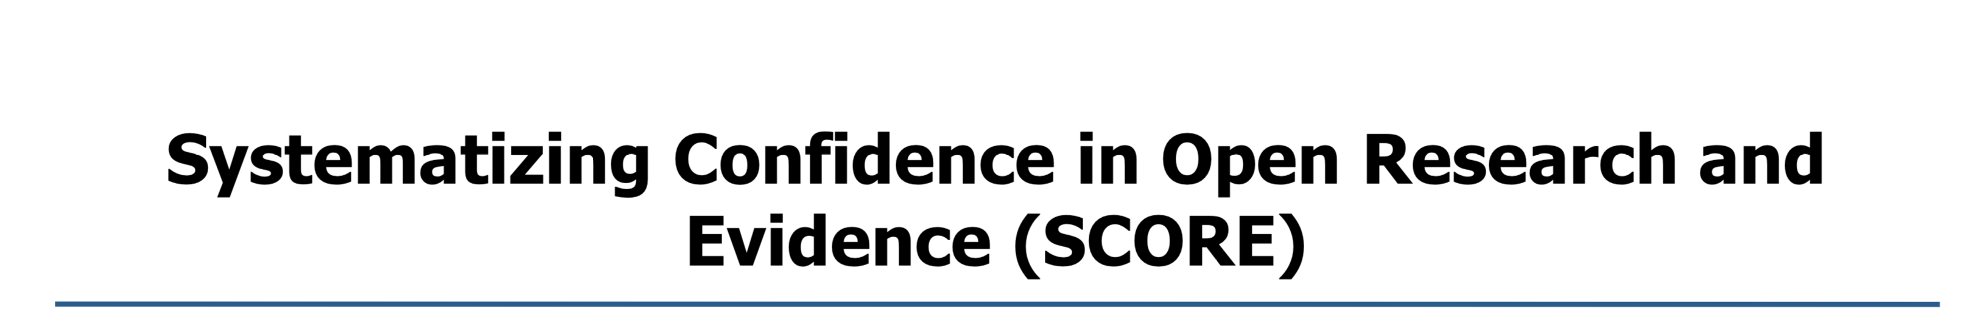
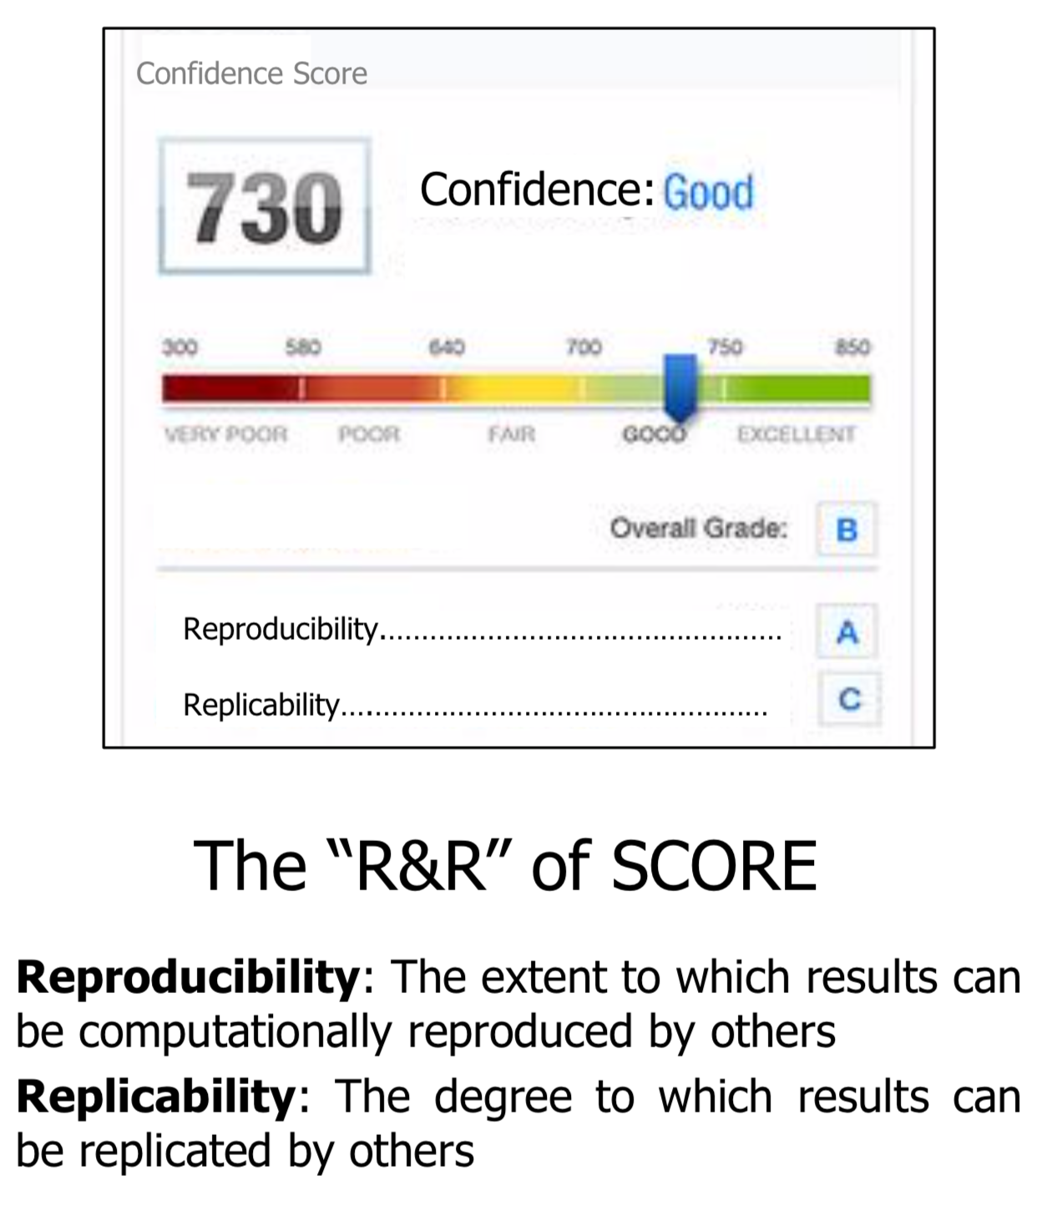
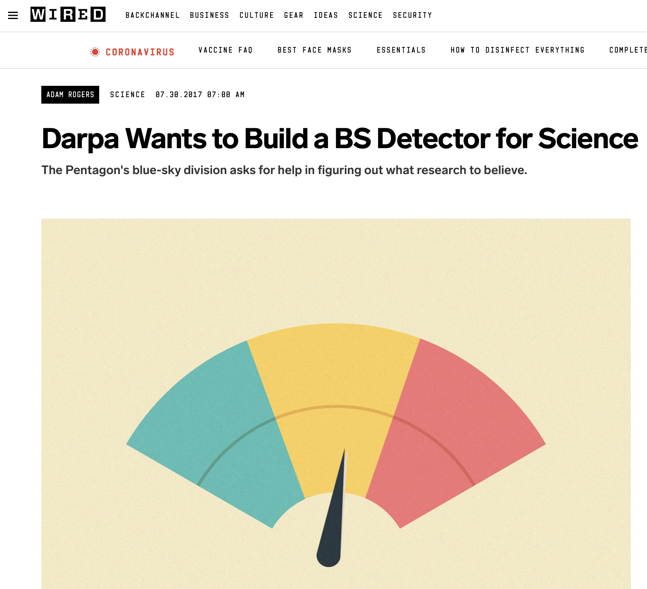
In 2018:
SCORE Objective: “Automated tools to quantify the confidence DoD should have in social and behavioral science (SBS) research claims”
Develop and deploy tools to assign explainable “confidence scores” to research results and claims
Notes:
Last summer, DARPA announced its follow-up to the Next Generation Social Science (NGS2) program – Systematizing Confidence in Open Research and Evidence (SCORE). The program’s objective is to develop: “Automated tools to quantify the confidence DoD should have in social and behavioral science research claims.”

Slide 27
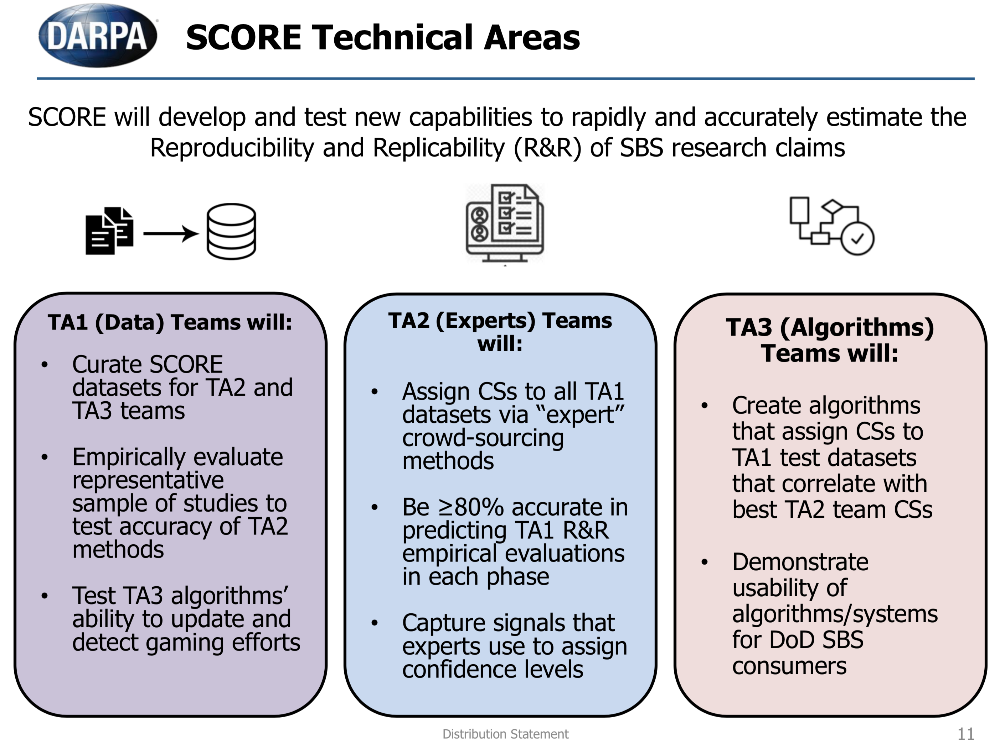
Notes:
What’s somewhat unique about DARPA programs is that they’re usually structured into Task Areas. Teams apply to address a given Task Area, the teams work together in a very structured way, with a government team umbrella. SCORE is structured into 3 TAs. The first is a data collection and curation Task. These teams are physically running replications of hundreds of studies to develop what will be taken as ground truth. TA2 will leverage teams of domain experts, also to develop ground truth and to determine the signals that experts use to recognize a claim as credible. And the TA3 teams will create algorithms (using data from TA1 and TA2) that can ingest a claim, and spit out R&R scores with explanations.

Slide 28




Synthetic Prediction Markets with Algorithm Traders for Determining Experimental Reproducibility

Slide 29
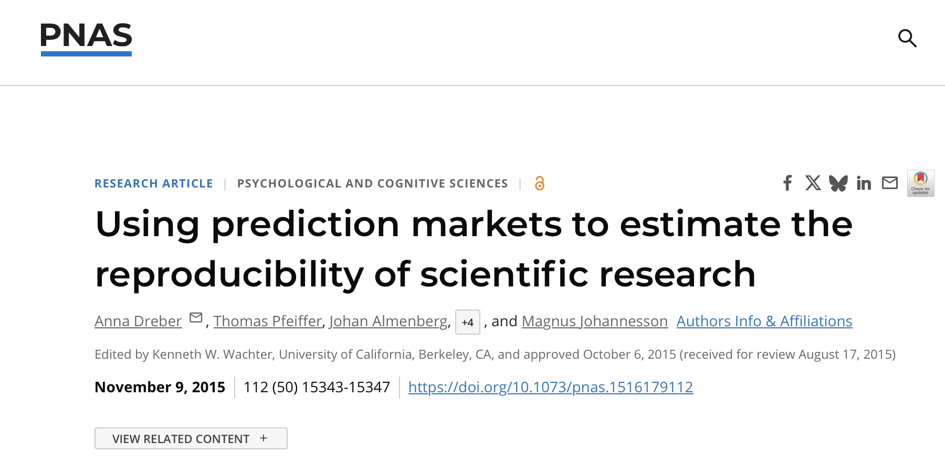
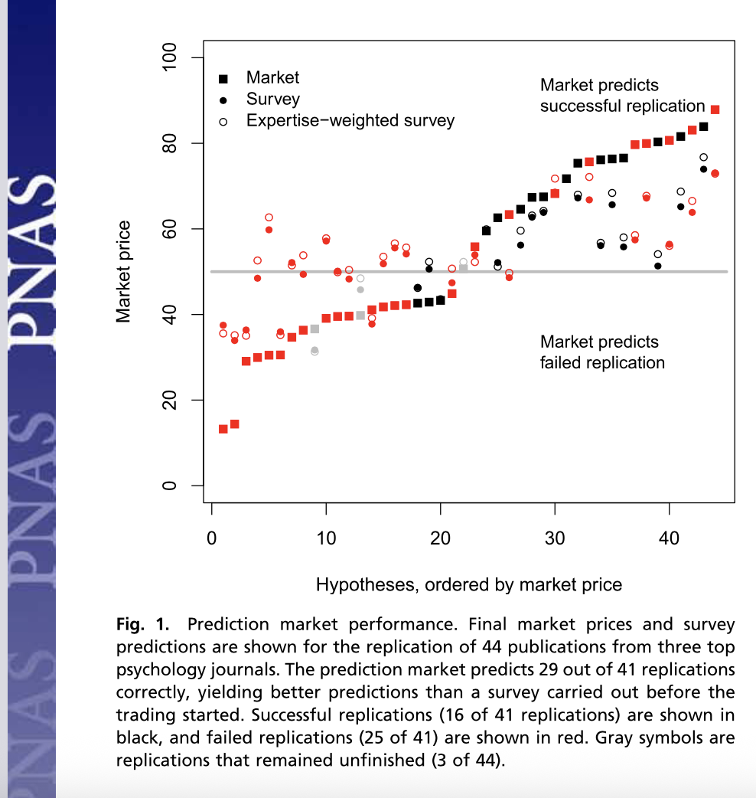
Our inspiration

Slide 30
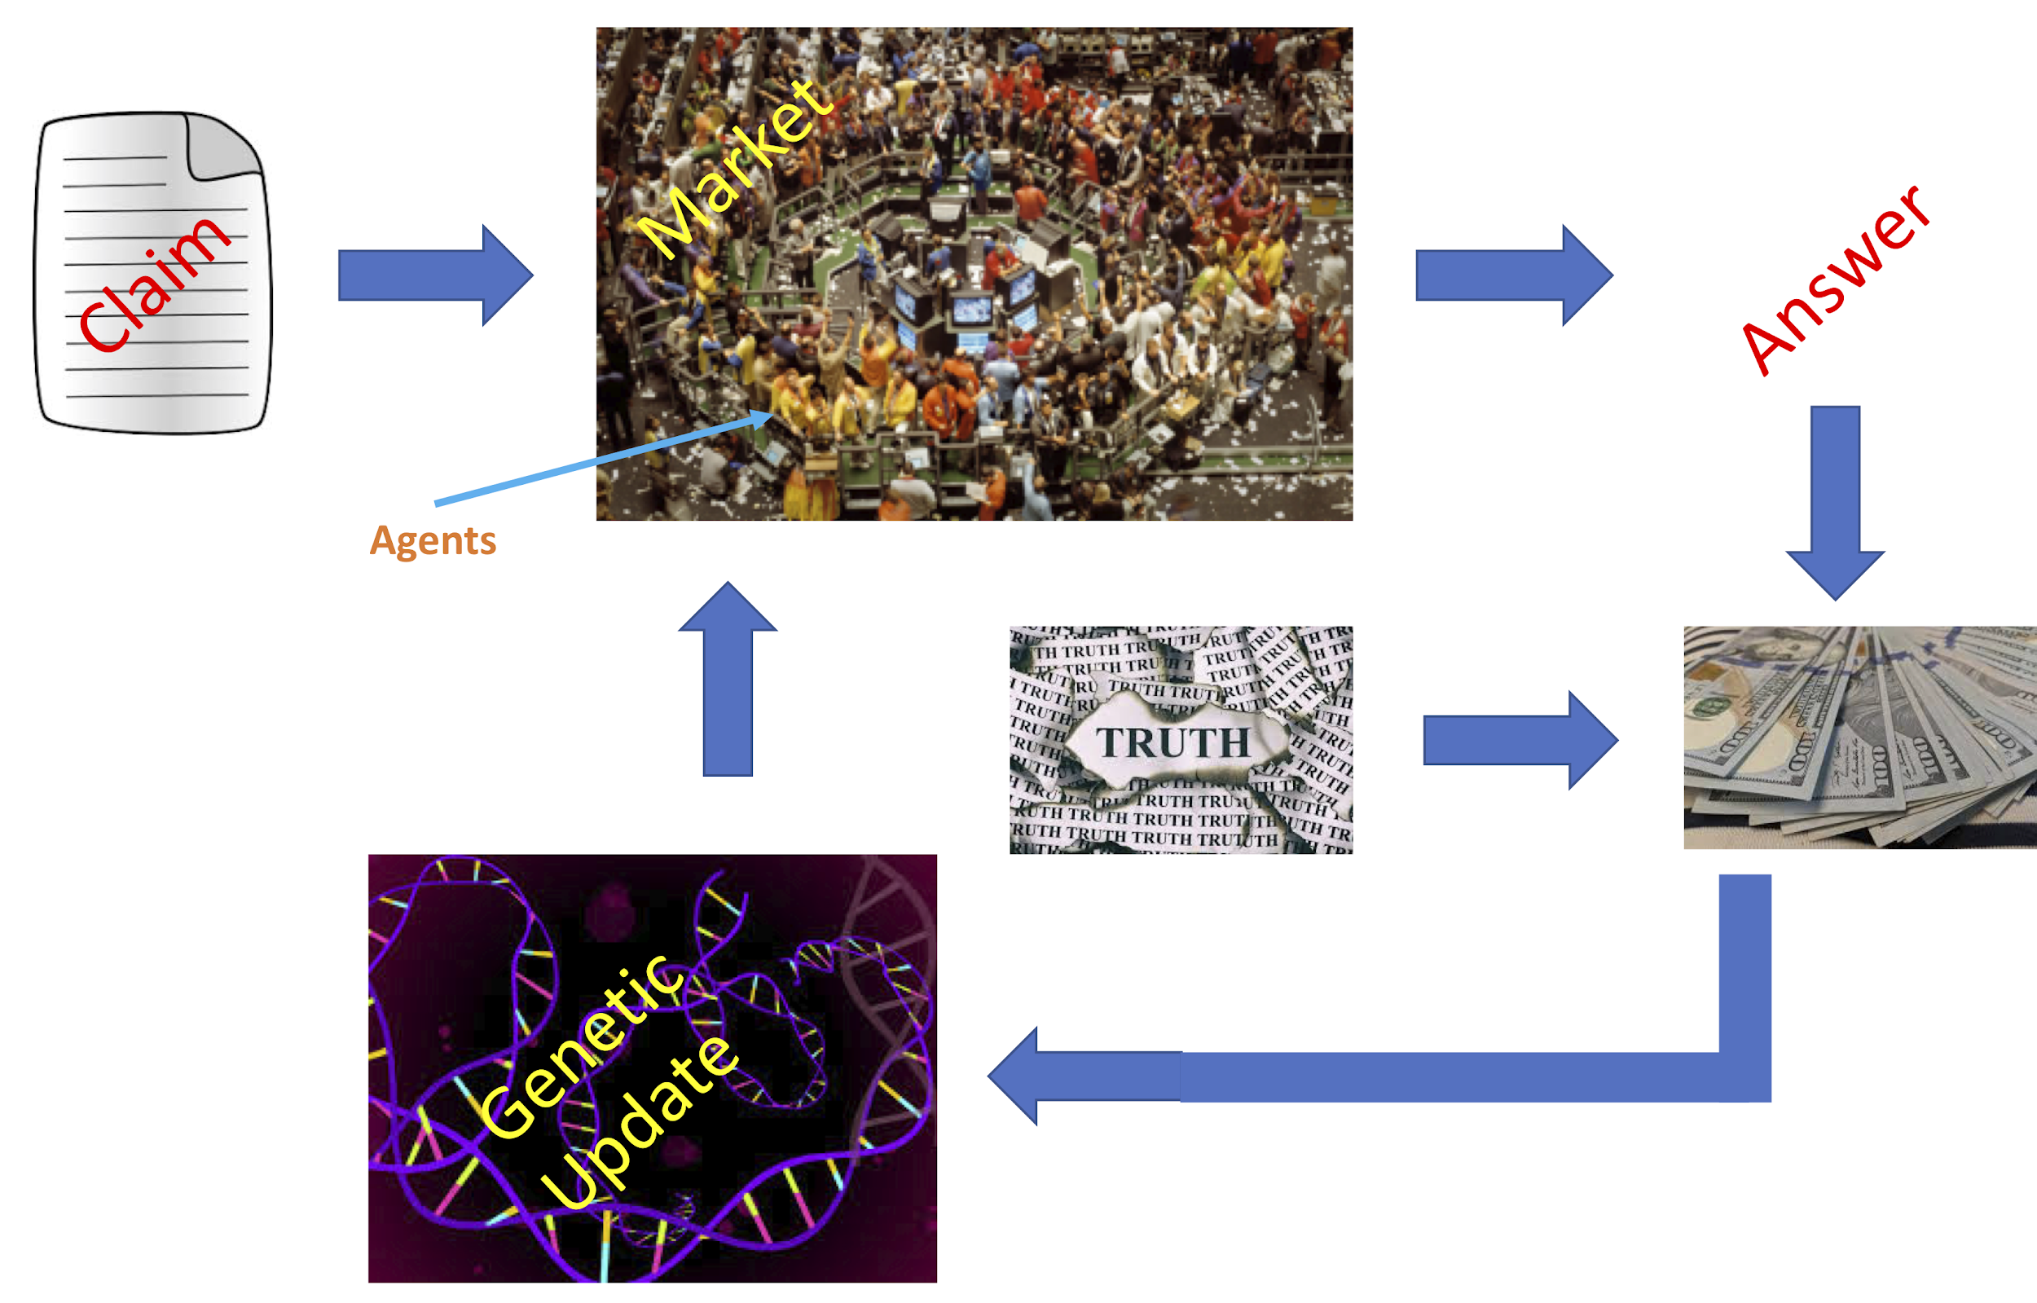

The artificial (AI) version
(2) Trader bots buy/sell assets corresponding to perceived replicability.
(3) A score is produced that is correlated with the terminal spot prices.
(5) Use a genetic algorithm to cull unsuccessful traders, and introduce cross-over, mutation and reproduction to iteratively improve performance.
(4) Profit/loss is a proxy for bots’ success.

Slide 31
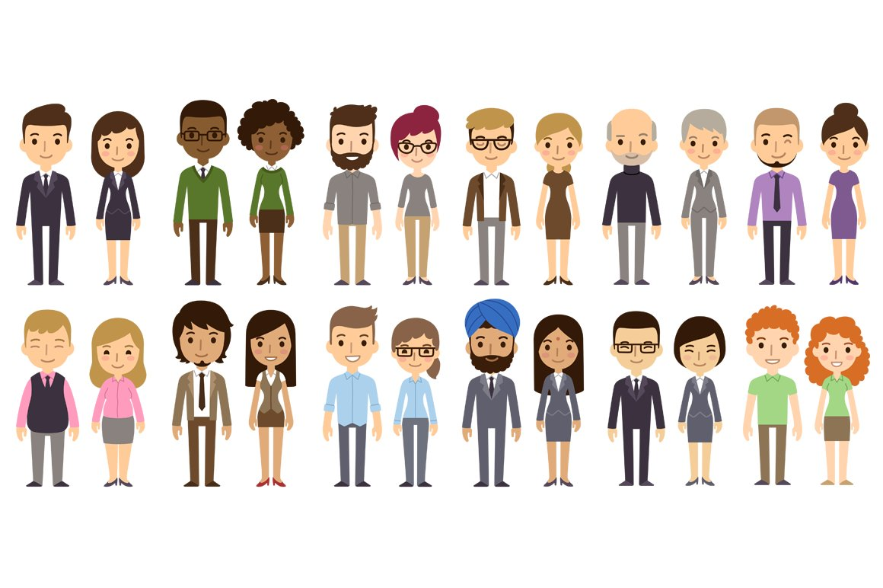

XAI (artificial prediction markets)
and crowd+AI hybrid markets
Artificial prediction markets ⏤ populated by artificial agents (trader-bots) ⏤ purchase assets representing “will replicate” and “will not replicate” outcomes of notional replications of claims appearing within research papers. Agent reasoning is based on human-interpretable signals, including full text of scientific papers, metadata for specific papers, and metadata about the community and the field.
Hybrid scenario: SMEs engage alongside bot traders

Slide 32

Signals (features) extracted from full text
and assembled from metadata
Negation
Citation Intents
p-value features
#StatCheck Errors
Claim embedding
#Theory/Model
Claims
#Theory/Model
Open access Dataset/Software
#StatCheck Err
Novelty
Citation features
Reference features
Full text and abstract
Readability
Sentiment
p-value features
Metadata
Funded
Age
Venue features
Author features
University rank
Open-access
Subject features
12
Claim level features
33
Citation features
15
Metadata features
Total:
~60 features

Slide 33
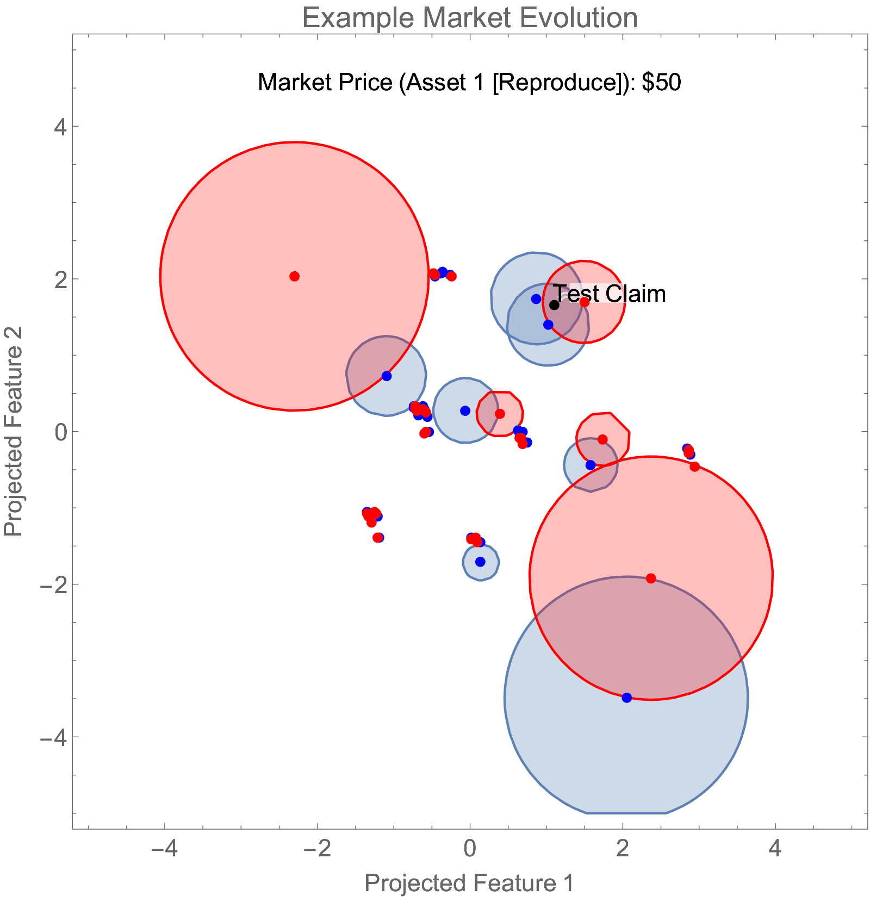
Artificial prediction markets
Synthetic agents interact in a simple binary option market using a logarithmic market scoring rule.
Agents in the market bid in geometric regions of feature space, shown as circles (for simplicity).
The agents are sensitive to asset price, which causes their bid behavior to evolve in time.
Convergence in the market is equivalent to a geometric equilibrium.
(above) A toy market with input data from RPP
Note 1: High dim feature space is projected down for visualization.
Note 2: We multiply the price by 100 and convert to dollars.)
Nakshatri et al. (2021) Design and analysis of a synthetic prediction market using convex sets. Results in Control and Optimization. https://www.sciencedirect.com/science/article/pii/S2666720721000308#

Slide 34
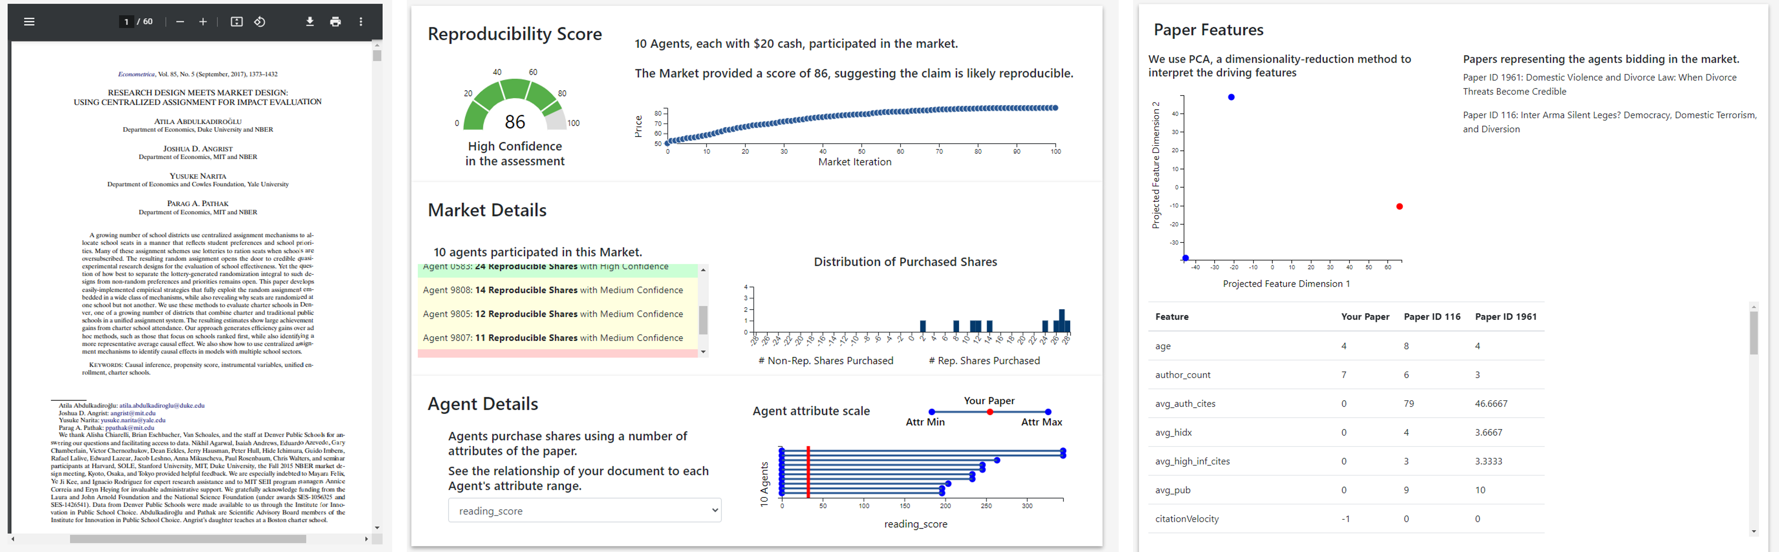
Prototype system
Claim submission: User submits a paper (PDF) for evaluation.
Feature Extraction: Extraction tools stage, followed by pass through feature extractor modules generate paper feature vector.
Evaluation through multiple prediction markets: The feature vector is passed through multiple markets and results from each are collected.
SCORE and interpretability: Results from the prediction markets are collated and a response containing the SCORE, interpretability and confidence is returned.
Level One: Confidence in the claim’s reproducibility through market score.
Level Two: Aggregated details related to agent participation in the system.
Level Three: Which agents participated + their confidence.
Level Four: Features corresponding to nearest training data points that influenced agents’ decision.
Is this useable and useful to stakeholders? Early take-aways: the features in context and explanations are as/more useful than the scores!

Slide 35

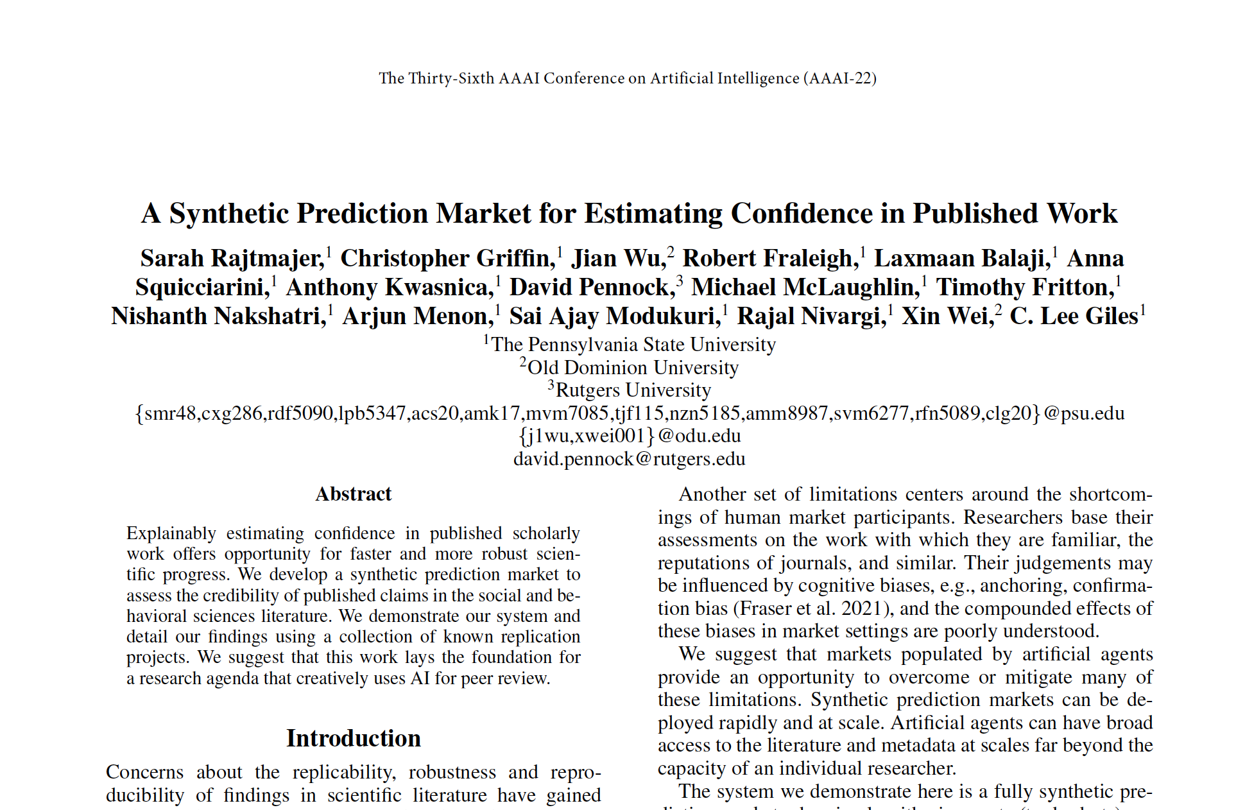
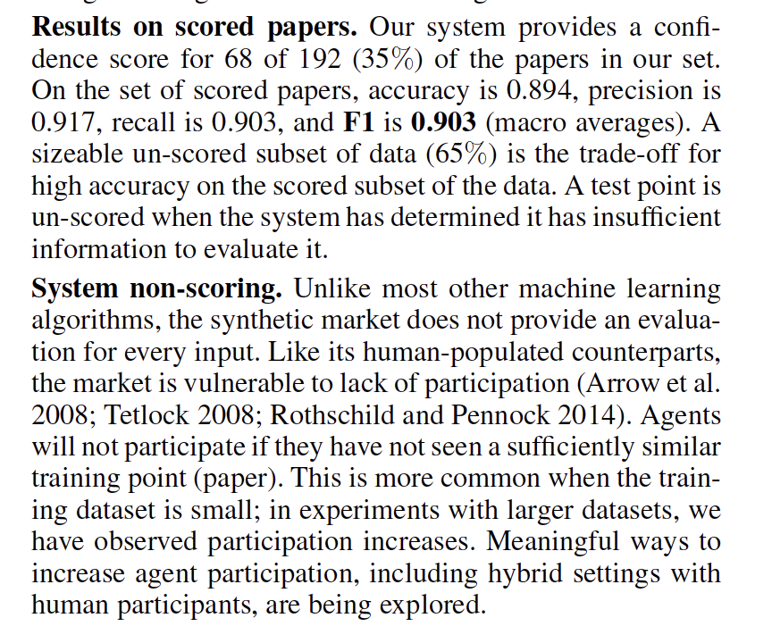
System evaluation --> real replication data

Slide 36
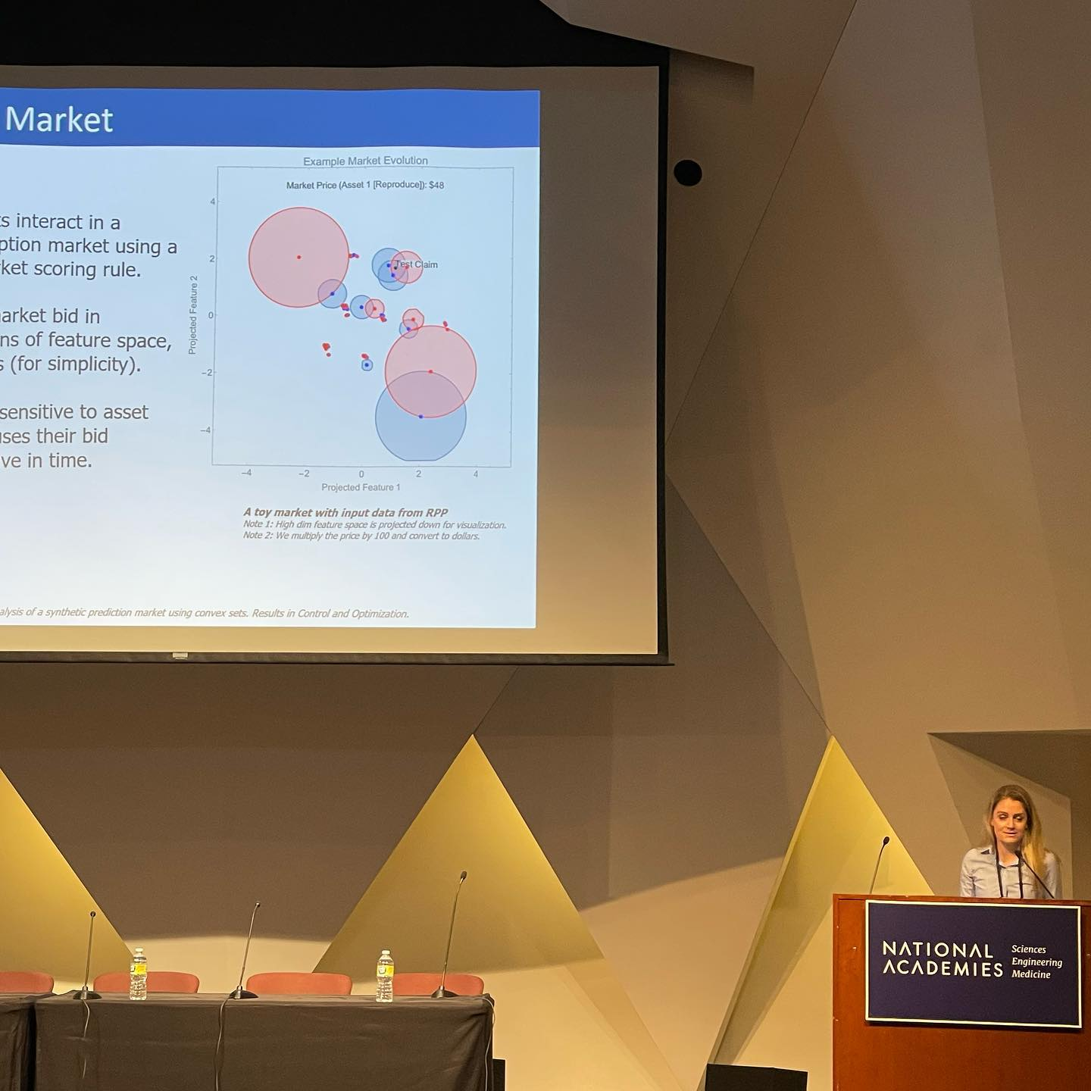
National Academies of Science! 2022
@The National Academy of Science in Washington, DC

Slide 37
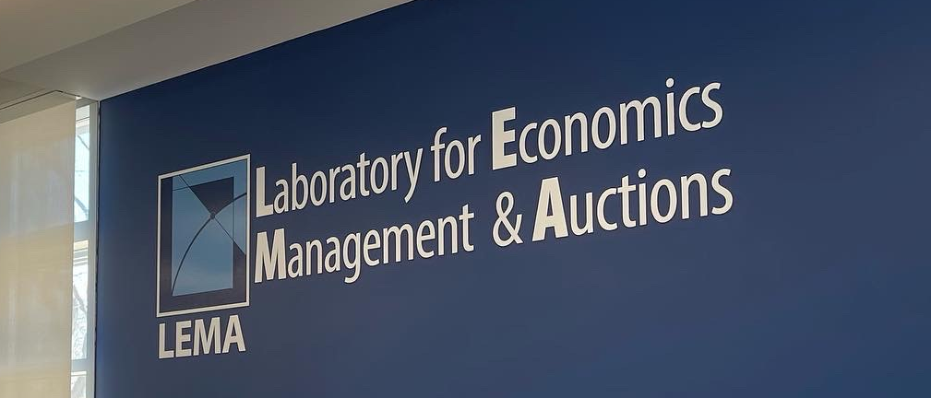
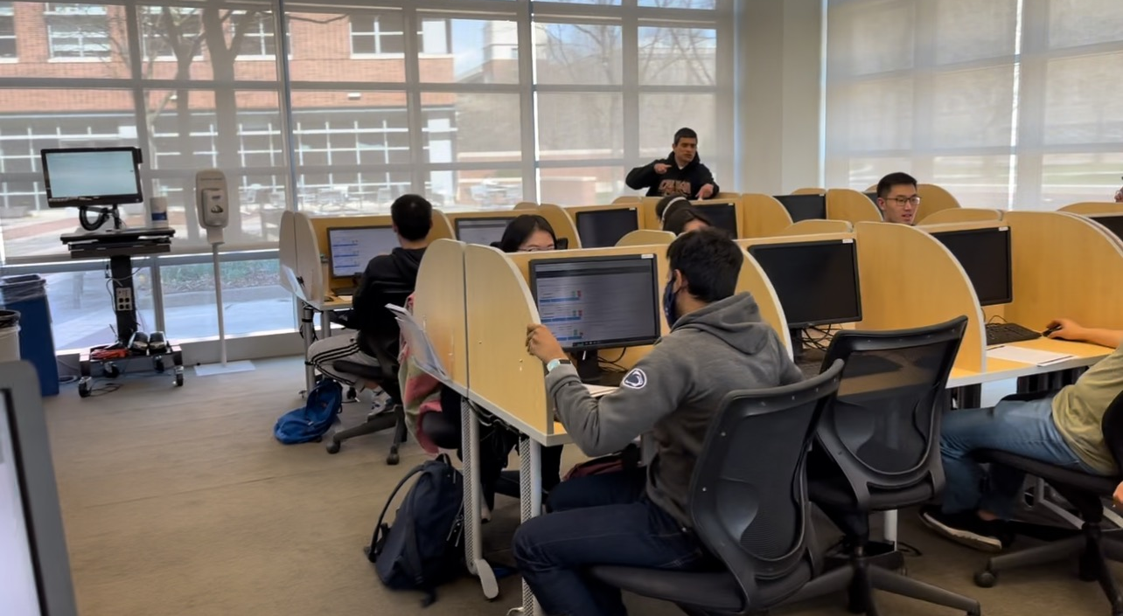
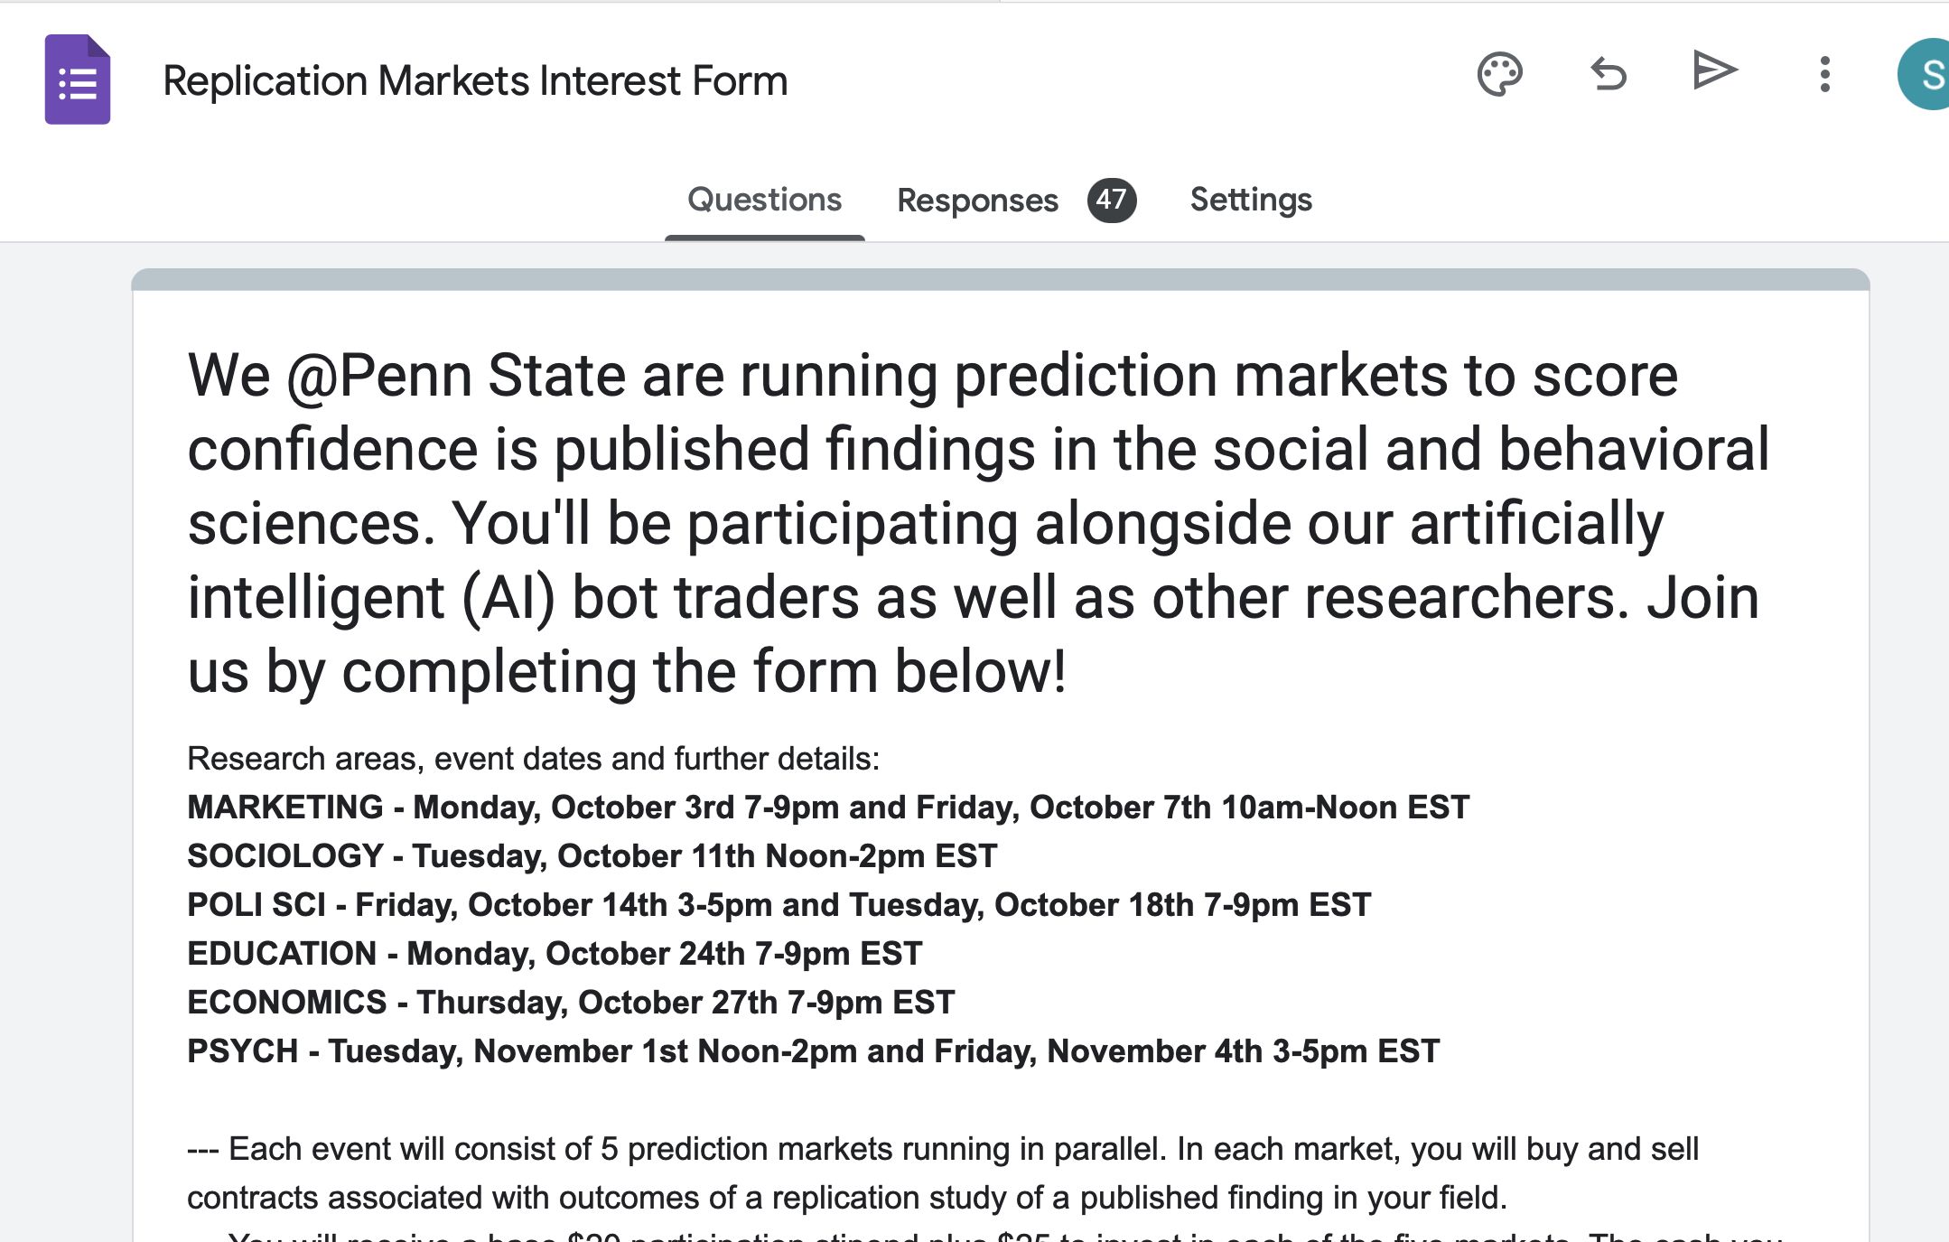
Hybrid prediction markets
Virtual 2-hour long market events
April and May 2023
100+ participants
Initial takeaways:
Major improvement in agent participation!
Change in individuals’ evals before/after market based on surveys
Need more work to understand the right “balance” of bots
Hybrid performs better than synthetic

Slide 38
Notes:
What’s somewhat unique about DARPA programs is that they’re usually structured into Task Areas. Teams apply to address a given Task Area, the teams work together in a very structured way, with a government team umbrella. SCORE is structured into 3 TAs. The first is a data collection and curation Task. These teams are physically running replications of hundreds of studies to develop what will be taken as ground truth. TA2 will leverage teams of domain experts, also to develop ground truth and to determine the signals that experts use to recognize a claim as credible. And the TA3 teams will create algorithms (using data from TA1 and TA2) that can ingest a claim, and spit out R&R scores with explanations.

Slide 39
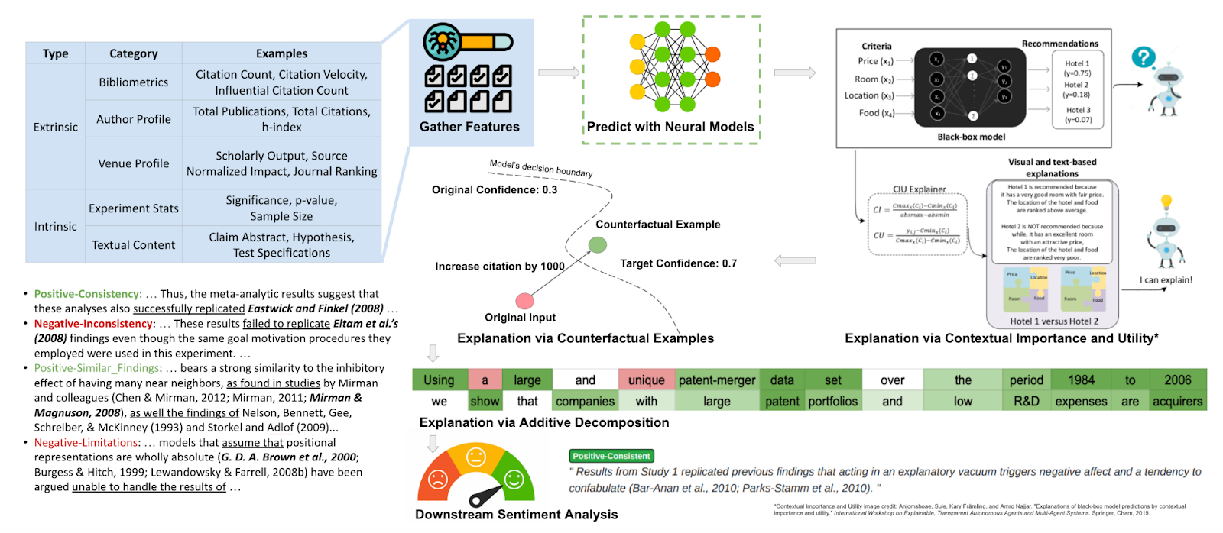
Texas A&M’s RES System.

Slide 40
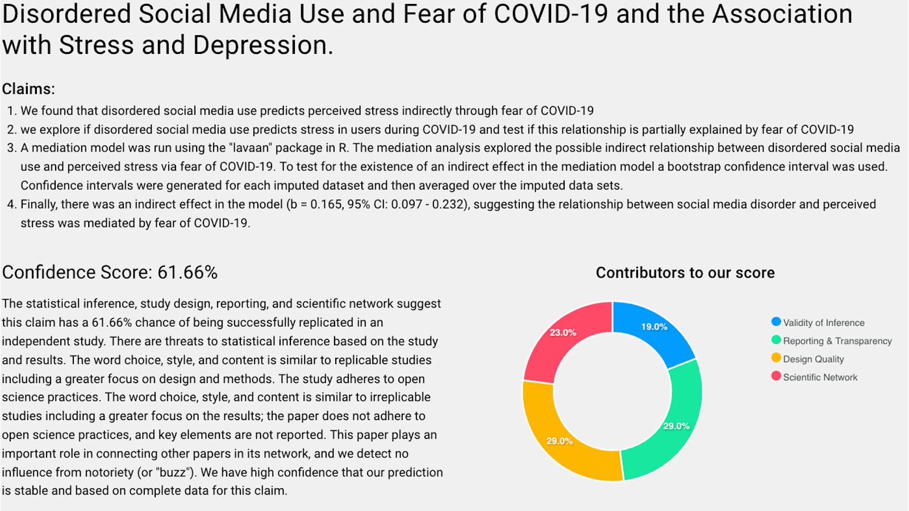
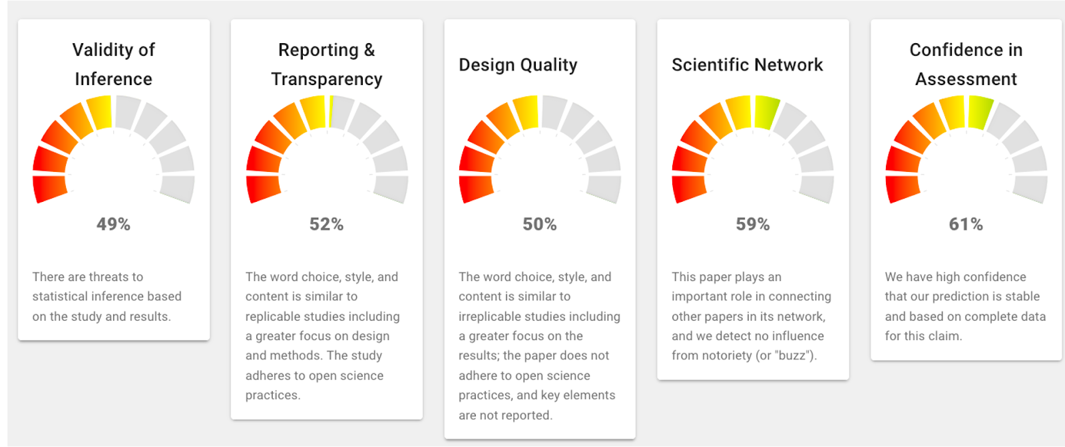
USC’s MACROSCORE

Slide 41
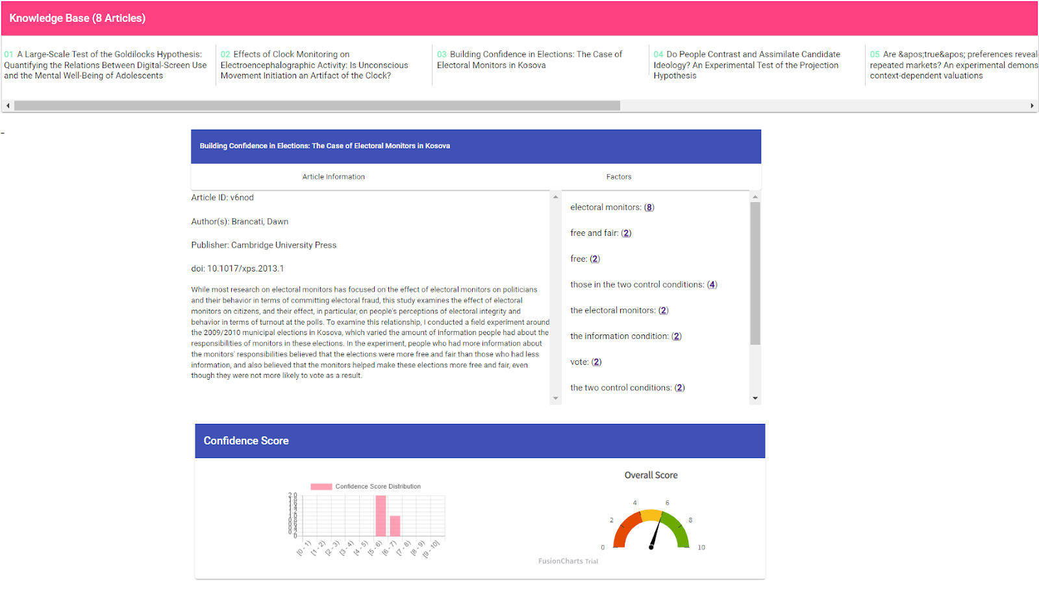
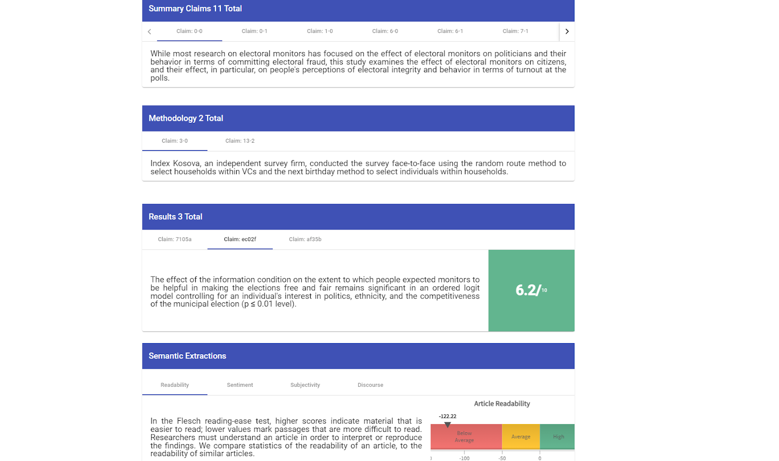
Two Six’s A+

Slide 42
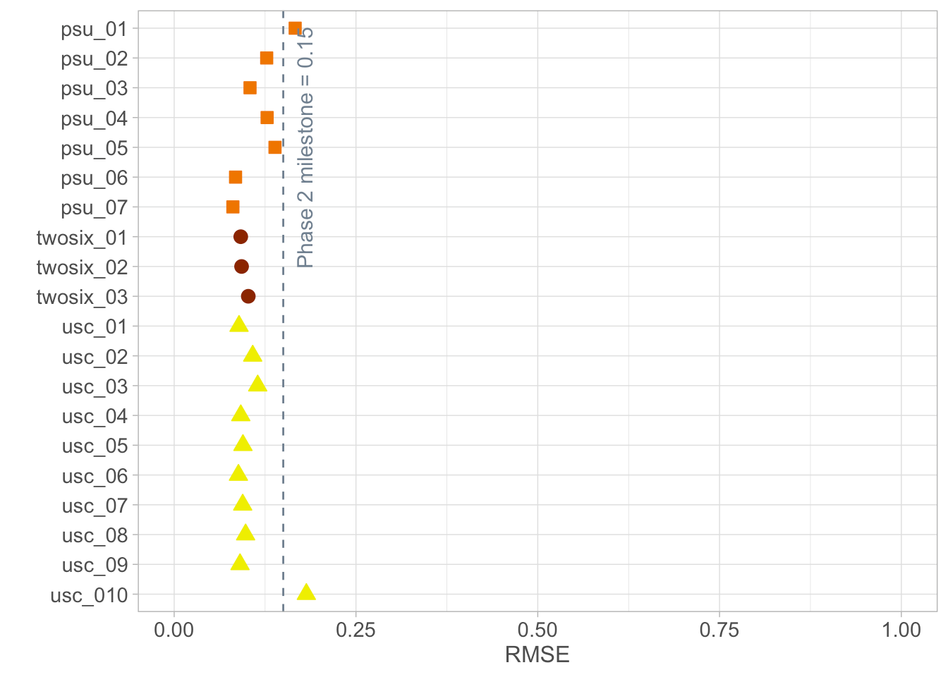
RMSE score distribution for TA3 teams’ Sprint 3 CSs (TAMU represented as psu_06 and psu_07)

Slide 43
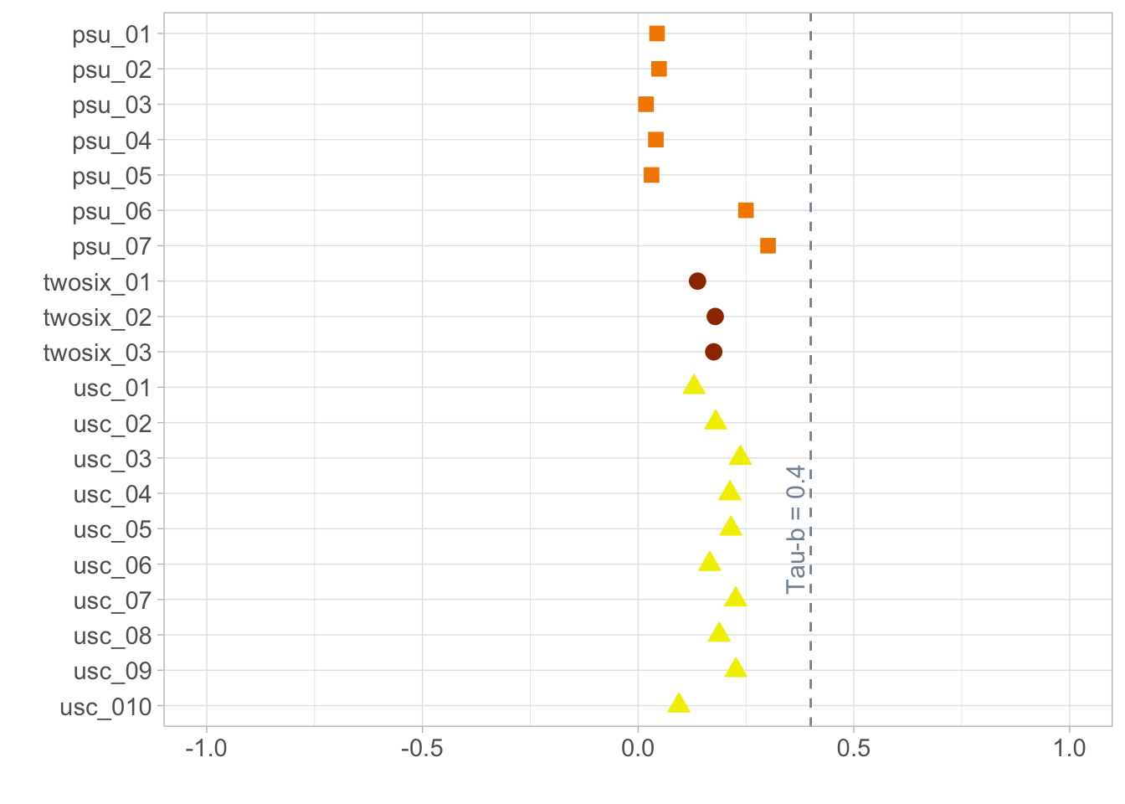
Kendall’s tau-b score distribution for TA3 teams’ Sprint 3 CSs (TAMU represented as psu_06 and psu_07)

Slide 44
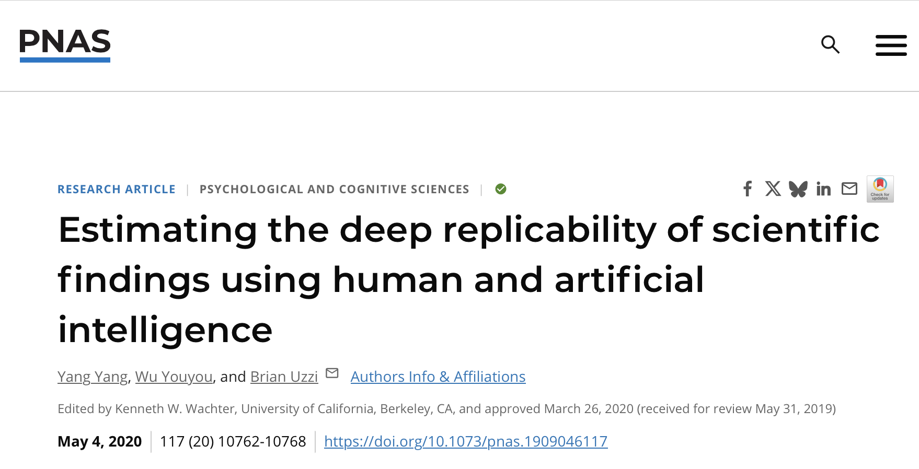
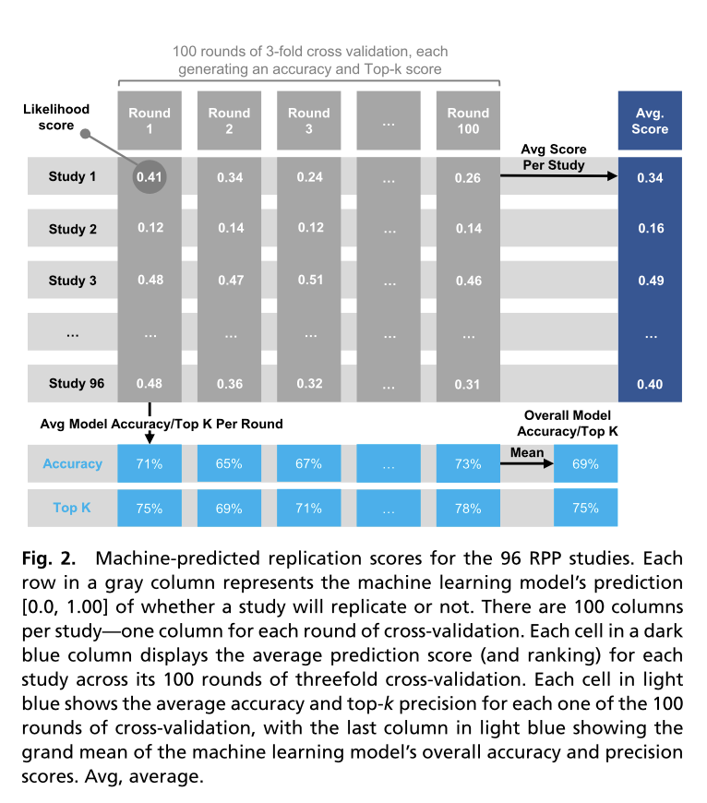
Meanwhile (not related to SCORE), in 2020:

Slide 45


Recently: LLMs to run reproductions
A First Look at the Reproducibility Crisis

Slide 46


Apple in our eye: LLMs to run replications
A First Look at the Reproducibility Crisis

Slide 47
Thank you for spending your hour with me!
A fundamental overhaul in the way we interpret and evaluate scholarship should make research more credible, more explainable, easier to synthesize, and more efficient! (time, cost, etc.).
These changes can and should leverage advances in big data and AI.
smr48@psu.edu

